Slide 1
The iala world-wide academy
Briefing to VTS47

Slide 2

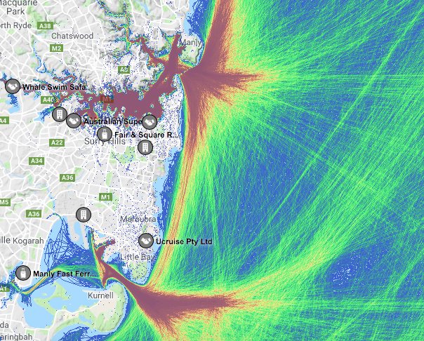
The problem – do I need a VTS?

Slide 3
Standard 1040 – Vessel Traffic Services
What do I need to do?
Standard 1040
Recommendation V-119
Do I need a VTS, if so what should it look like?
Recommendation R0127
What kind of procedures do I need?
Recommendation V-128
What equipment and technology do I need?
Recommendation R1012
How should we communicate with vessels?
Recommendation R1013
How do I monitor our performance?

Slide 4
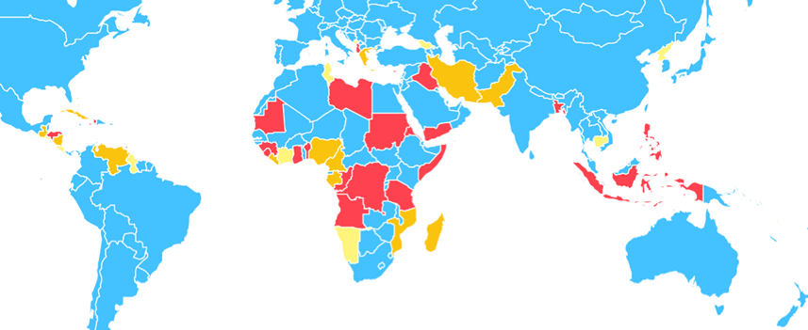
Capacity Building for VTS
Priority 1
Priority 2
Priority 3

Slide 5
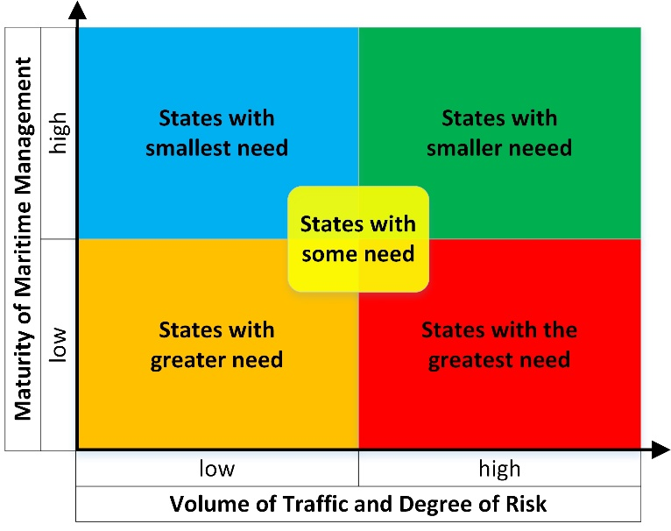
Capacity Building for VTS
Priority 1 States have the greatest need,
Priority 2 States have a greater need,
Priority 3 States have some need.

Slide 6

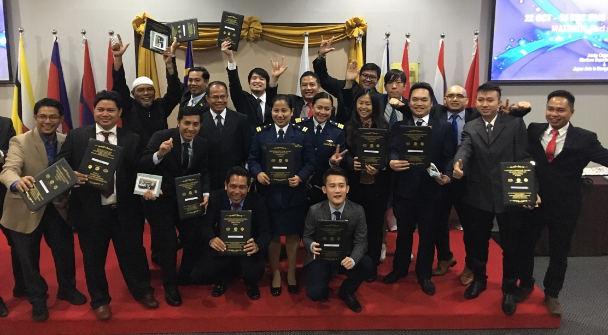
Standard 1050 – Training and Certification
What do I need to do?
Standard 1050
Recommendation R0103
How do I recruit and train my team?
Recommendation O-149
How should training organisations be run?
V-103/1 - Operator
V-103/2 - Supervisor
V-103/3 - OJT
V-103/4 – OJT Instructor
V-103/5 - Revalidation

Slide 7

IALA Seminar on VTS Training – save the date
200+
Sunday 24 June 2020

Slide 8
Questions?
Contact: kevin.gregory@iala-aism.org

