Slide 1

New Technologies – New Opportunities e-Navigation Underway 2019
Anne H. Steffensen CEO of Danish Shipping @AnneHSteffensen

Slide 2
The 6th largest shipping nation & growing…..

Slide 3
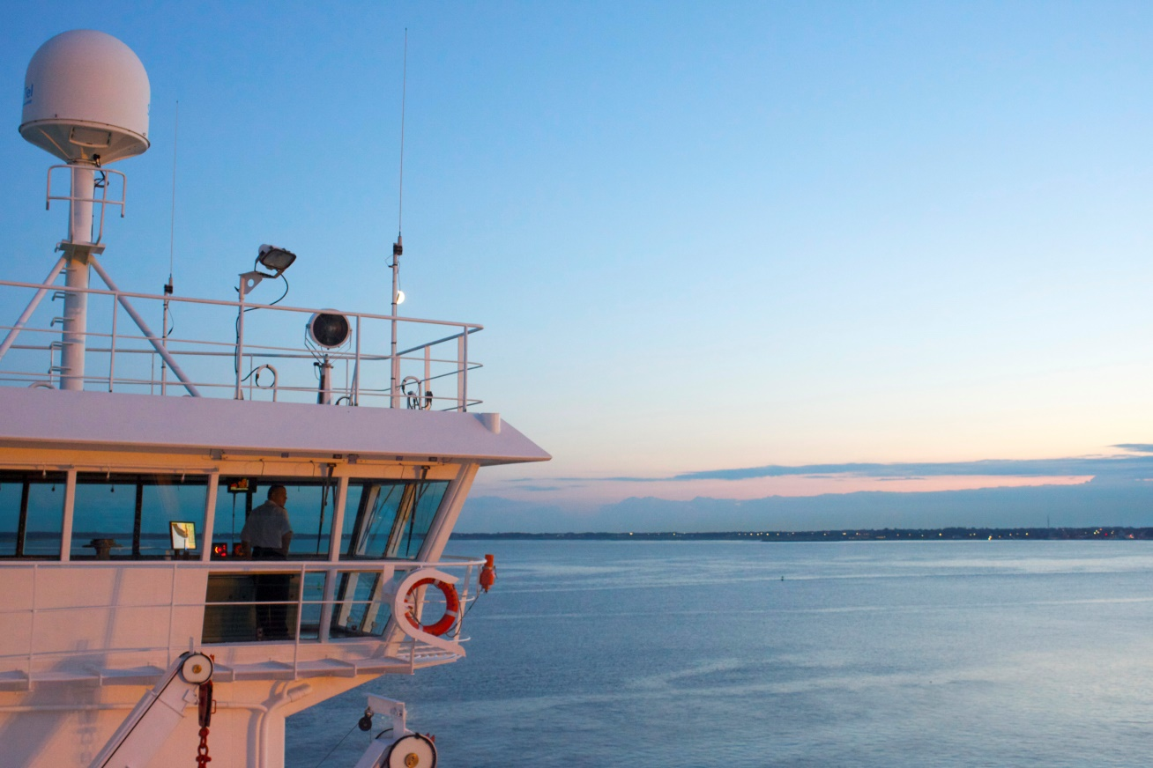
New technologies – new opportunities

Slide 4

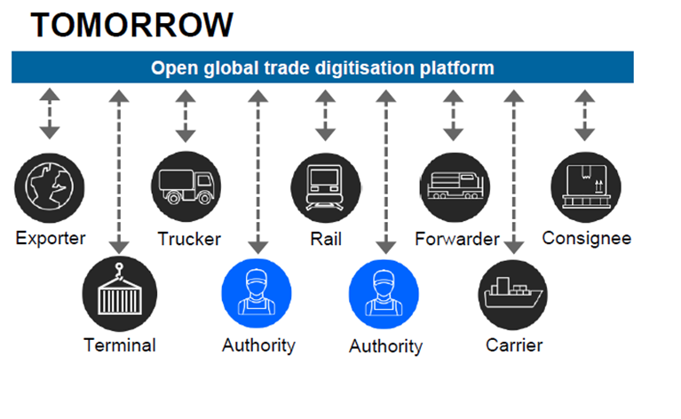
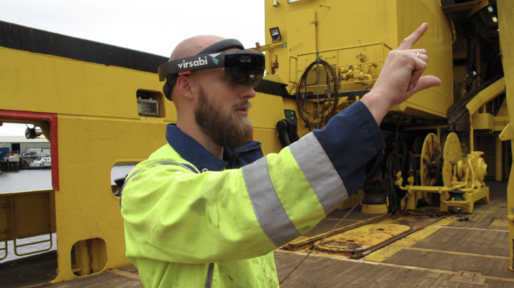
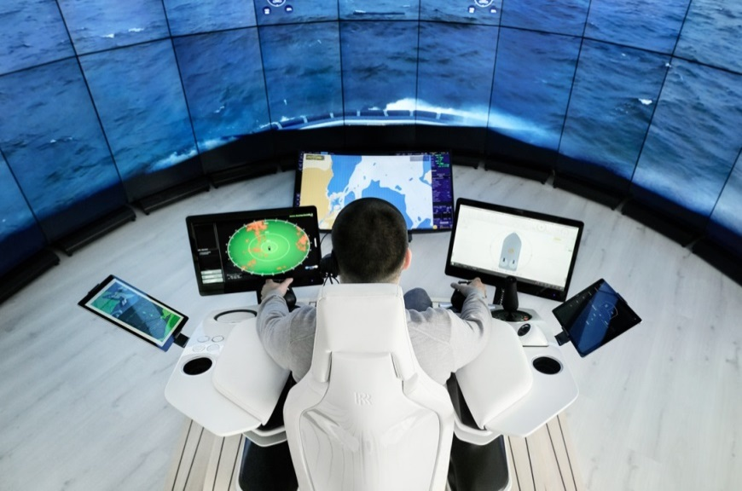
Land based technology
Digitizing Global Trade
Sea based technology
Autonomous vessels
XR for assisted humans

Slide 5
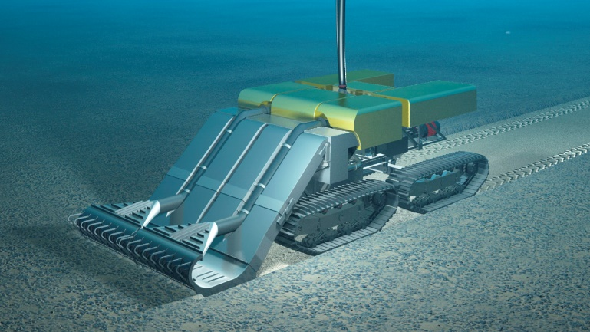
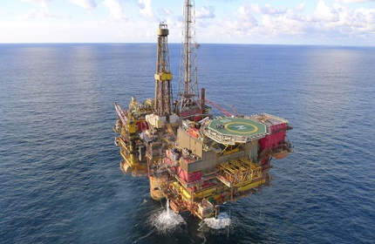
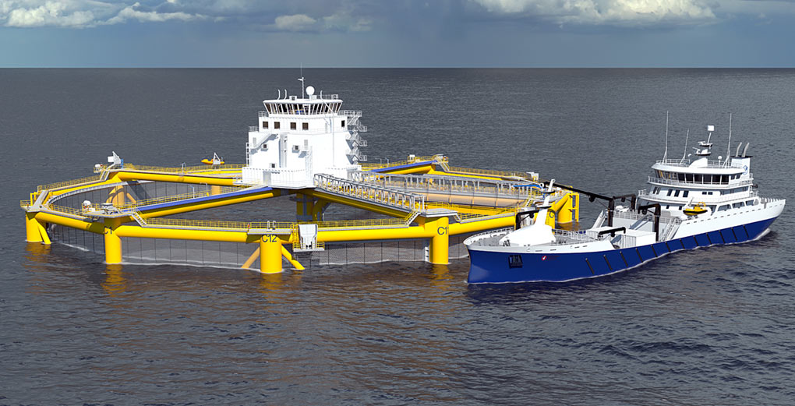
The Ocean Economy
New business areas:
Sea bed mining
Offshore farming
Offshore wind
??

Slide 6

Regulation
Need for updated IMO
regulation to support
development of new
technologies
Regulation as driver for
innovation

Slide 7

New technologies – new challenges
Have your IT systems been the subject of an attempted attack during the last 12 months?
Source: Danish Shipping CEO Survey November 2017

Slide 8


Thank you

