Slide 1

E-Nav Underway 2019
  Rules, Regulations, Guidelines, Standards and Reality.
  What does this all mean for Autonomous Vessels?
James Fanshawe CBE
Chairman UK MASRWG
16th April 2019
E-Nav Underway 2019
  Rules, Regulations, Guidelines, Standards and Reality.
  What does this all mean for Autonomous Vessels?
James Fanshawe CBE
Chairman UK MASRWG
7 February 2019

Slide 2

Autonomy Backdrop
The growth of autonomy continues to rise exponentially.
New systems and concepts are being developed month by month.
Novel technologies are entering service in a variety of forms.
These are not all to do with so-called unmanned vessels.
There are some intriguing benefits being identified for conventional ships.
The focus, when it comes to Standards and Regulation, tends to fall on the introduction and operation of vessels that will not necessarily have personnel on the bridge.
These vessels may be strictly autonomous but it is more likely that they will be monitored or supervised remotely.

Slide 3
Regulation – Where are we?
Definitions and terminology industry.
IMO Regulatory Scoping Exercise for Maritime Autonomous Surface Ships (MASS).
A variety of Rules and Guidelines are in force.
Many standards can be directly applied to these vessels but there will be a need for some new ones.
Dichotomy - the regulatory and standards work is bound to lag behind the reality of an ever increasing number of vessels which are operational.
Whether these vessels are truly autonomous, or being monitored or supervised from a remote station, is not the key question.
They must all be seen to be operating within existing regulatory frameworks and standards.
Safety is paramount.
Trust is a keyword.
Precedent law portfolio growing.

Slide 4
IMO Regulatory Scoping Exercise
The Organization should be proactive and take a leading role on this issue.
RSE to review IMO’s international regulatory framework and to:
  Determine which provisions apply or not to MASS and may preclude or not MASS operations (as currently drafted)
  Identify gaps or issues and analyse the best way to address.
Need to take into consideration the human element and legal aspects.
Not a “drafting exercise”.
The work on MASS should be user-driven and not technology driven.
LEG 105 (April 2018) RSE with a target completion year of 2023 for LEG instruments.
MSC to take a coordinating role.
Henrik Tunfors – RSE Chair. Jan 2019

Slide 5
IMO Scoping Exercise
Framework – Definition. For the purpose of the regulatory scoping exercise, MASS is defined as:
“A ship which, to a varying degree, can operate independent of human interaction”
Framework – Degrees of autonomy
1. Ship with automated processes and decision support
2. Remotely controlled ship with seafarers on board
3. Remotely controlled ship without seafarers on board
4. Fully autonomous ship.
Framework – Methodology
  First step: to identify provisions in IMO instruments which, as currently drafted:
    First step “regulation by regulation”
  Second step: to analyse and determine the most appropriate way of addressing MASS operations, taking into account, inter alia, human element, technology and operational factors by:
    Second step “high level”.

Slide 6
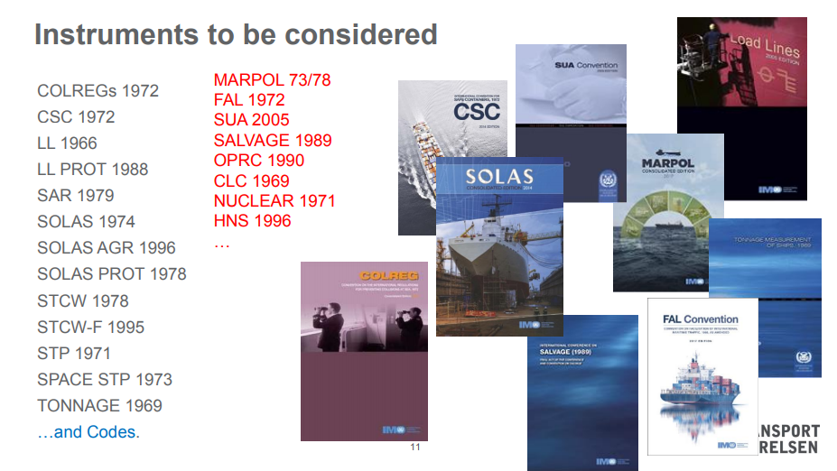
IMO Scoping Exercise

Slide 7
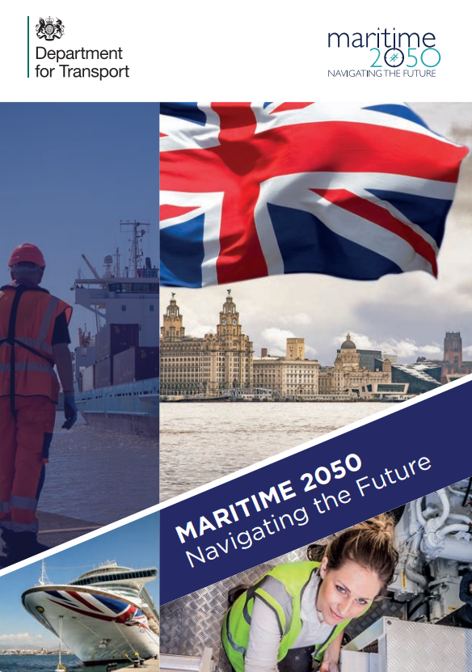
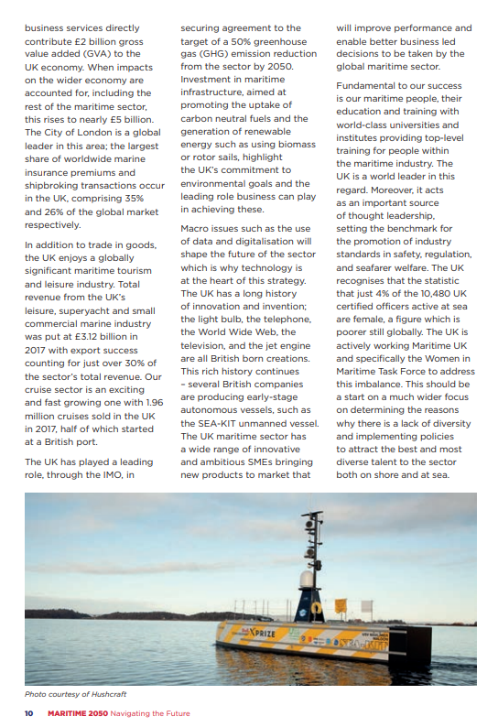
UK Policy
https://www.gov.uk/government/publications/maritime-2050-navigating-the-future

Slide 8
Industry Codes
Pan industry agreement on aspects of MASS development, design, production and operation
Best practice
Assurance
Safety and professionalism
Training, conduct and personal responsibility
Compliance and self-regulation
Improved communications within the industry and the wider maritime community

Slide 9
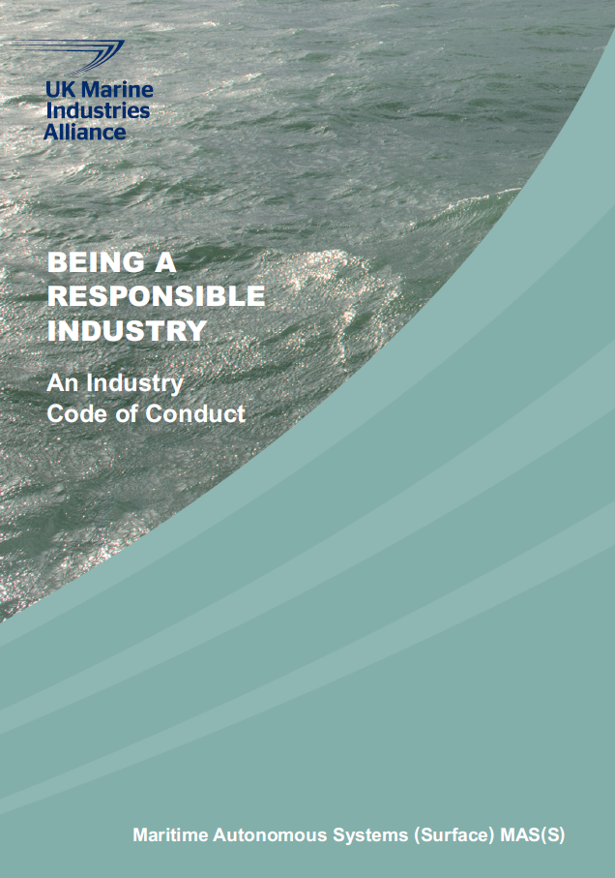
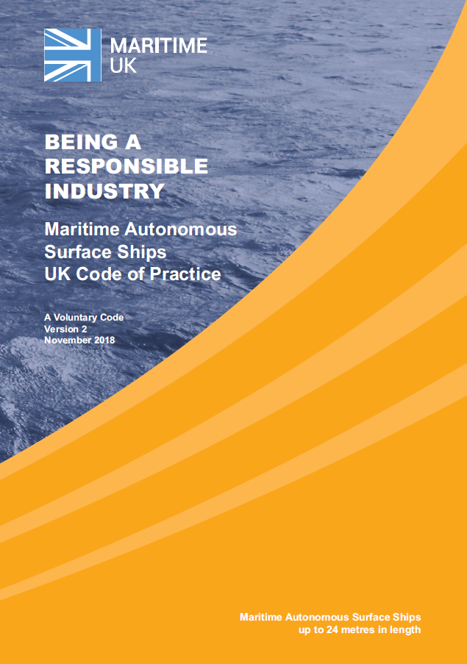
UK Codes of Conduct & Practice
Published March 2016
Version 2.0 published 13 November 2018
https://www.maritimeuk.org/media-centre/publications/

Slide 10

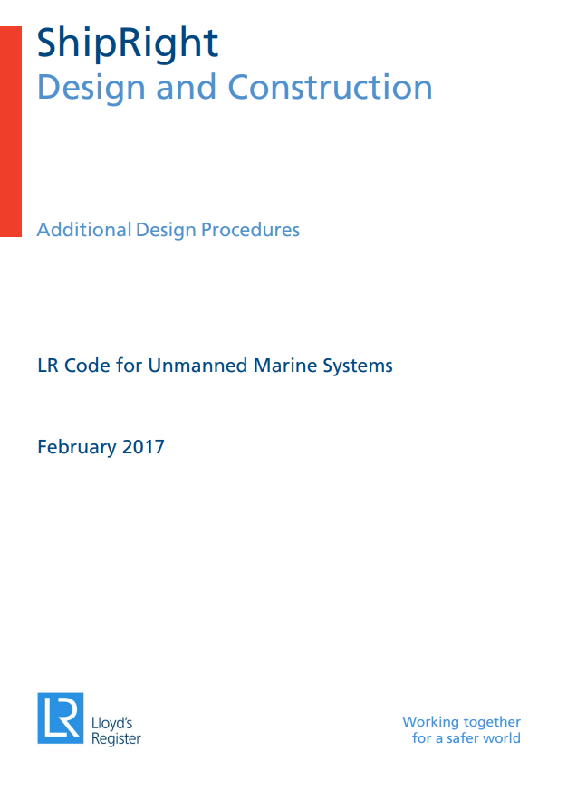
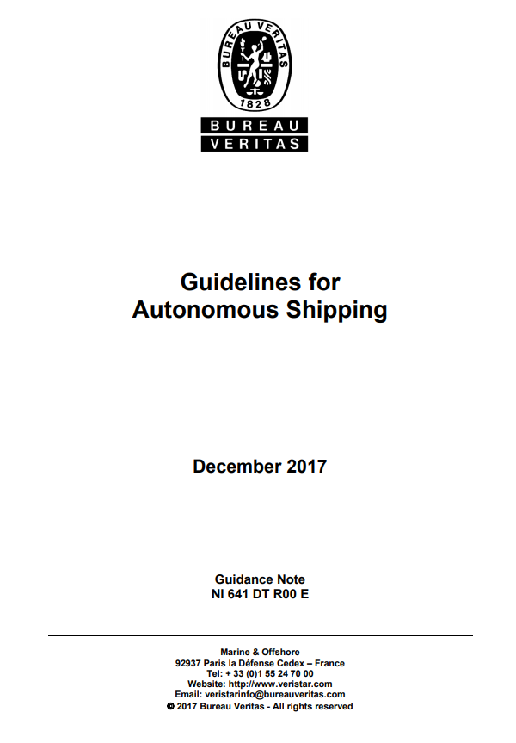
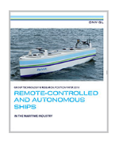
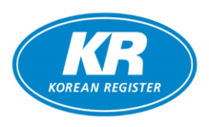

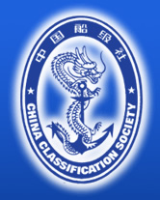
Classification Societies

Slide 11
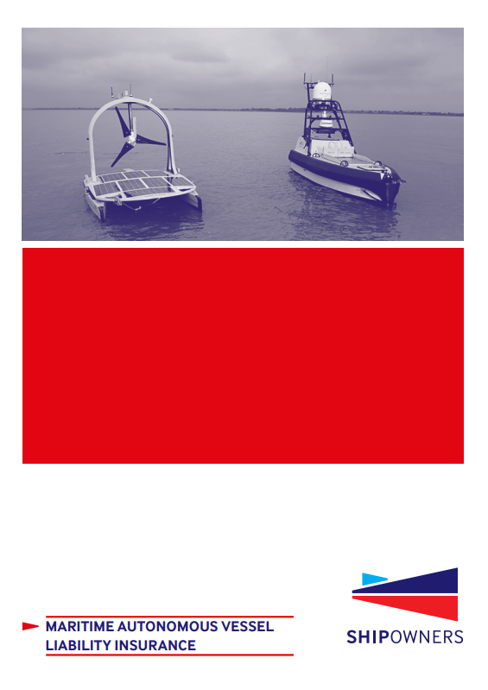
Insurance
“Our specialist policy was developed to meet the liability insurance needs of owners and operators of autonomous and remotely operated vessels. Cover is provided on a plain language policy wording, underwritten on an ‘all risks’ basis, to provide a very comprehensive level of cover.”

Slide 12
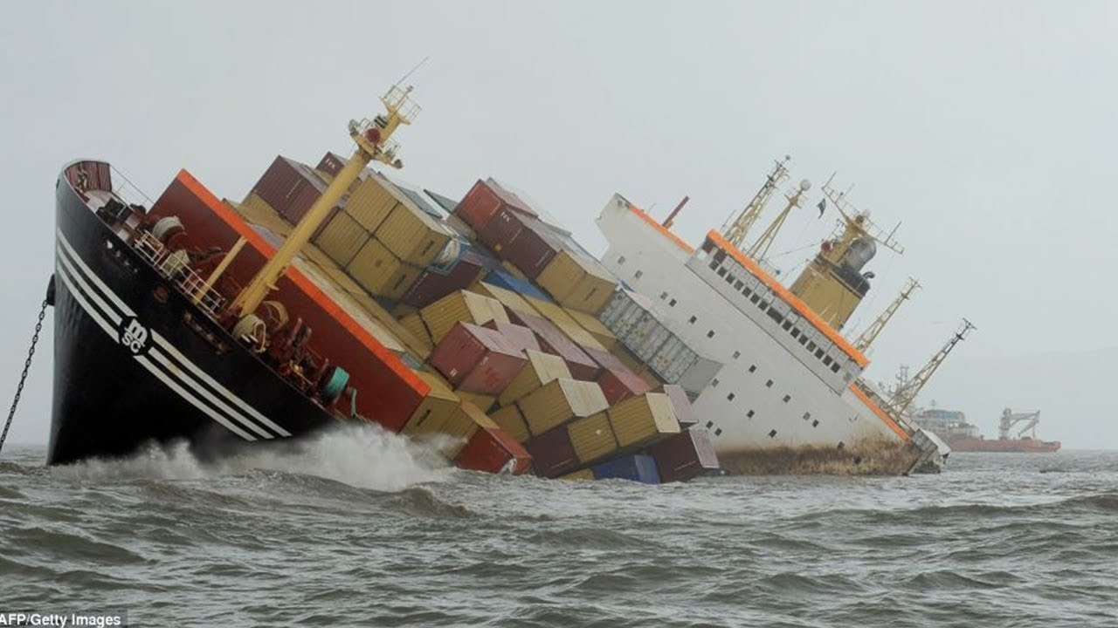
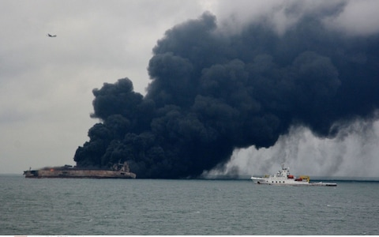
Reality check - Maritime Accidents
MSC ZOE 2018
SANCHI 2018
About 75-96% of marine casualties are caused, at least in part, by some form of human error. Studies have shown that human error contributes to:
• 84 - 88% of tanker accidents
• 79% of towing vessel groundings
• 89 - 96% of collisions
• 75% of allisions
• 75% of fires and explosions

Slide 13
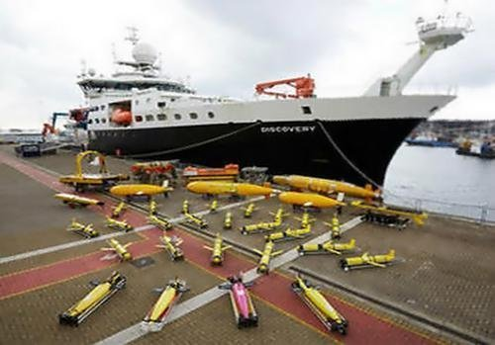
Maritime Autonomous Systems
Contributions to Safety at Sea
Commercial operations
  Maritime Transport
Oil and Gas
Marine Scientific Research
  Marine Survey
  Oceanography
  Passive acoustic monitoring
  Offshore research
  Deep sea mining
  Fishing and aquaculture
Underwater asset management
Defence operations
Maritime and Border Security
Communications Relay (e.g. SAR)

Slide 14
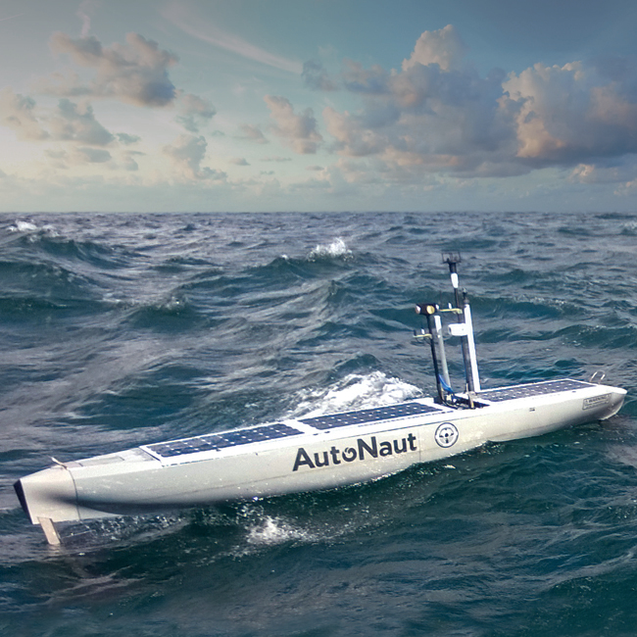
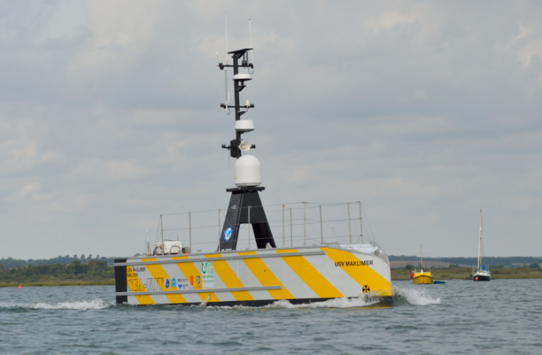
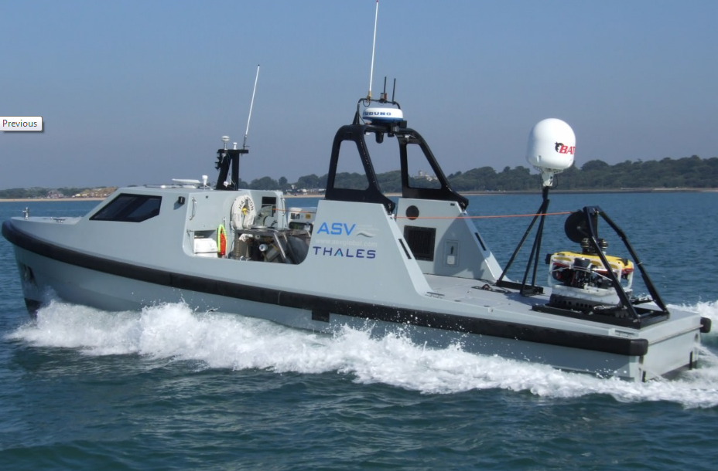
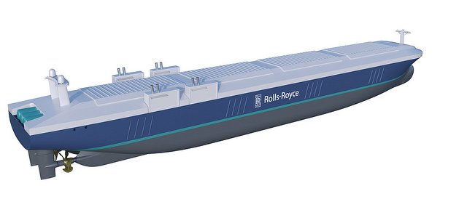
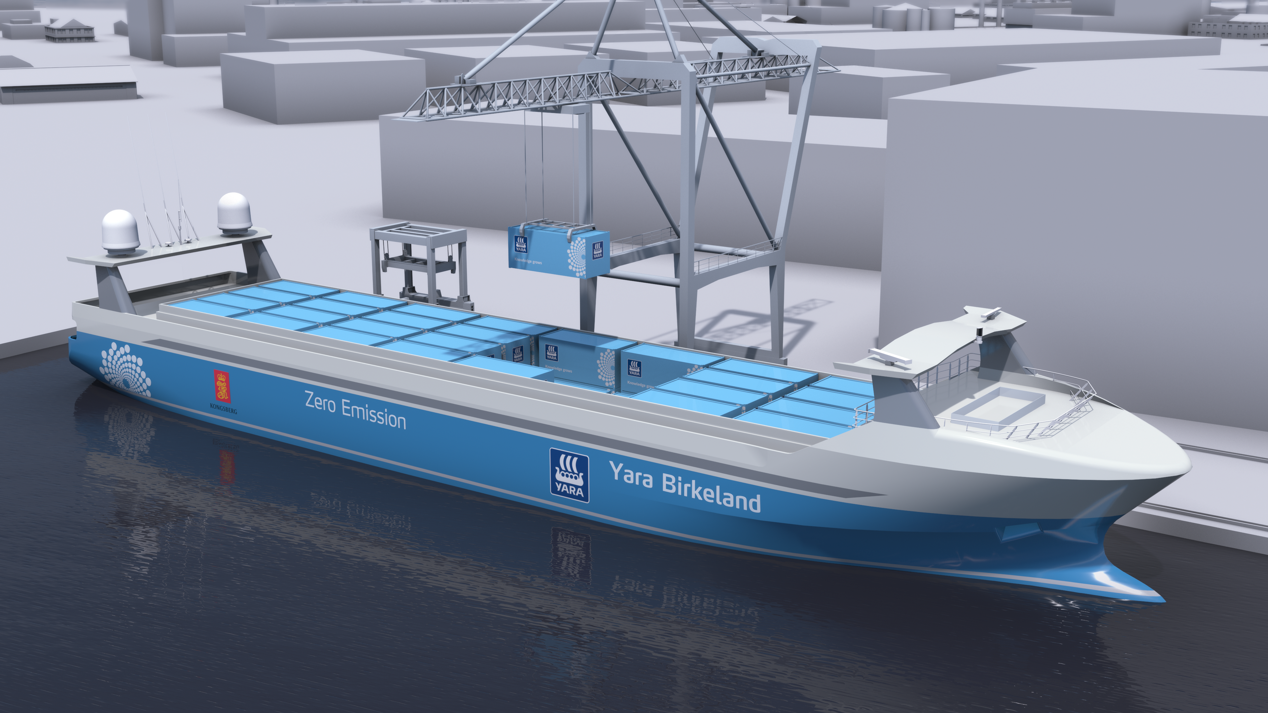
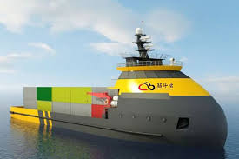
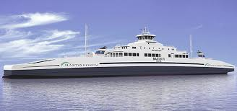
Maritime Autonomous Surface Ships (MASS)

Slide 15
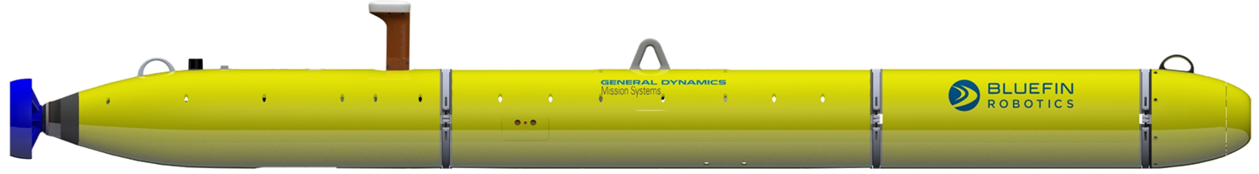
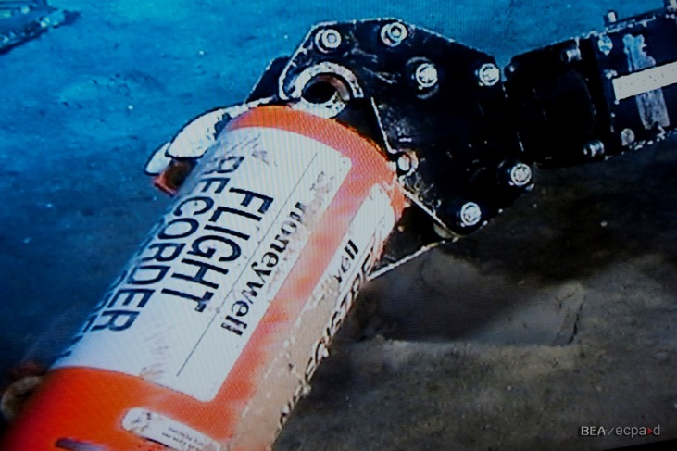
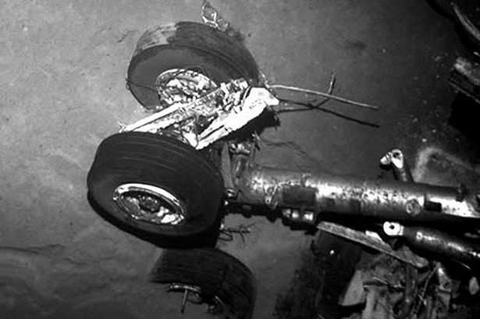
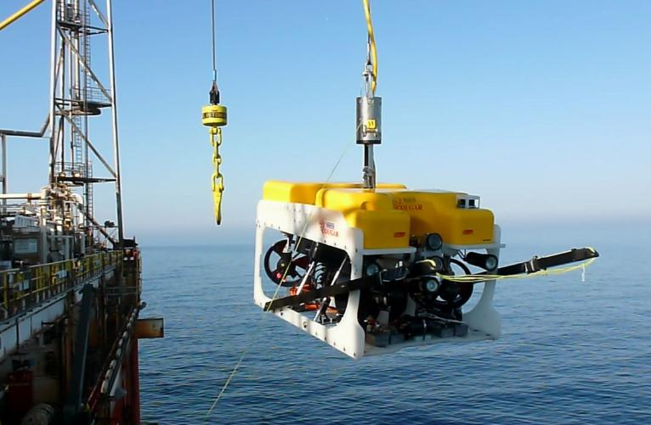

Unmanned Underwater Vehicles and Remotely Operated Vehicles

Slide 16
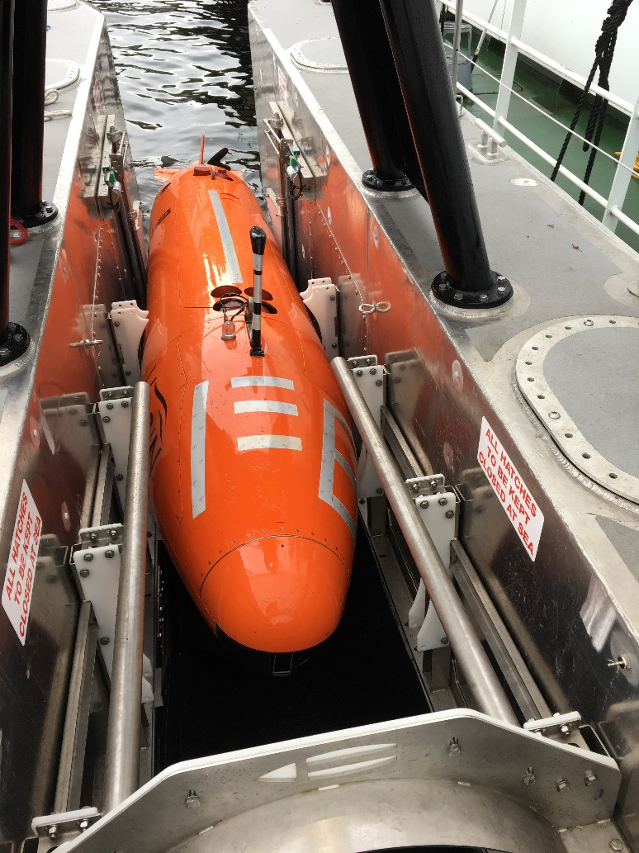
Autonomous Underwater Vehicles operated from a MASS
SEA-KIT vessels are designed to act as a mothership for Autonomous Underwater Vehicles (AUVs), this is a unique capability that currently requires manned vessels to complete. SKI XP is fitted with a Kongsberg Maritime 351 HiPAP (High Precision Acoustic Positioning) which acted as a positioning baseline for AUV’s and ROV’s. (Remotely Operated Vehicles).
AUV charging and data downloading can be performed automatically allowing for extended operations without human intervention.
SEA-KIT with embarked Hugin UUV

Slide 17
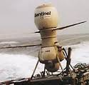
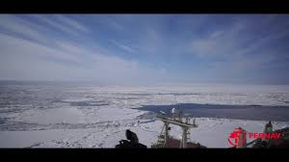
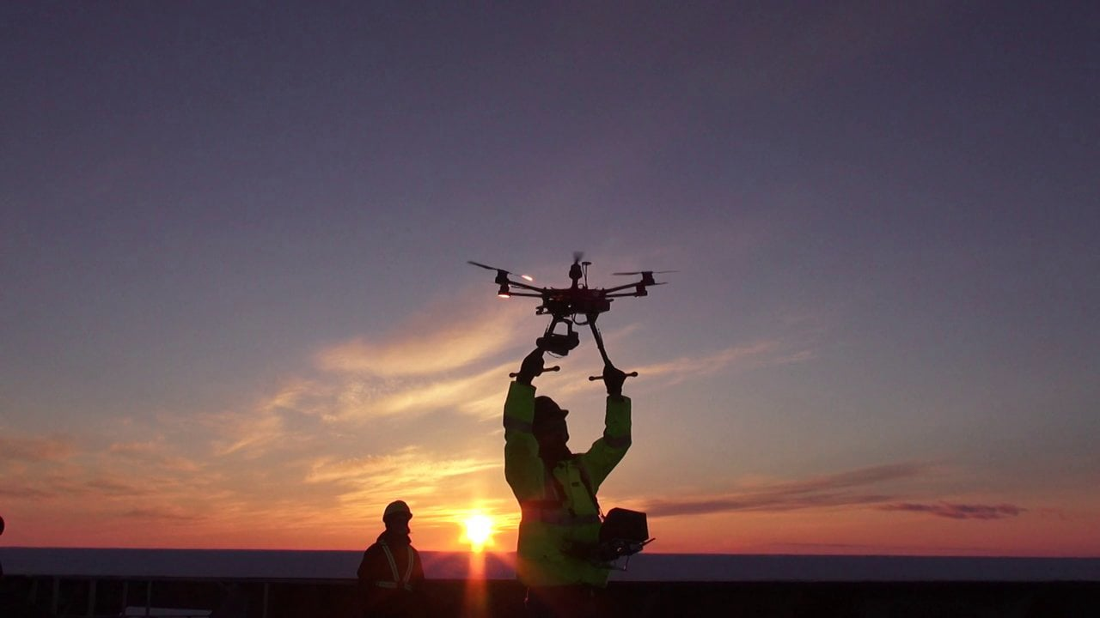
Unmanned Air Systems at Sea
Sentinel UAV flying from HMS CLEOPATRA 1990
Fednav vessel using UAV for Ice Reconnaissance
Notes:
Schiebel Camera Copter
RFA Cardigan Bay and Scan Eagle (700 NAS)

Slide 18
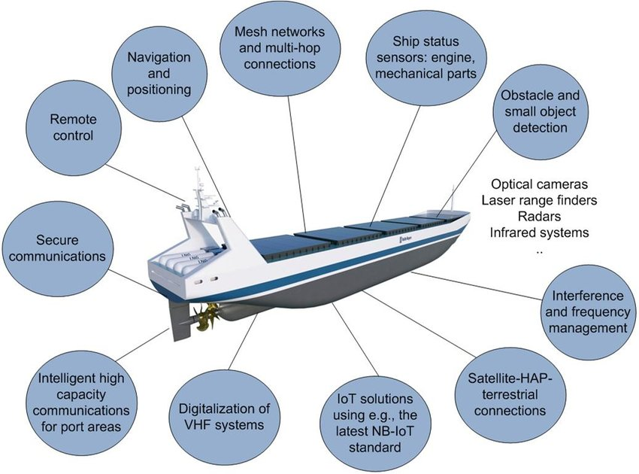
MASS Communications & Cyber

Slide 19
The Human Element
Considerable effort is being made to establish training standards and accreditation.
The Maritime industry needs to attract and retain bright people.
It is no longer a case of considering the ships alone.
The maritime story starts at the factory and stops at the point of delivery.
Plenty of jobs but they will be different than today.

Slide 20
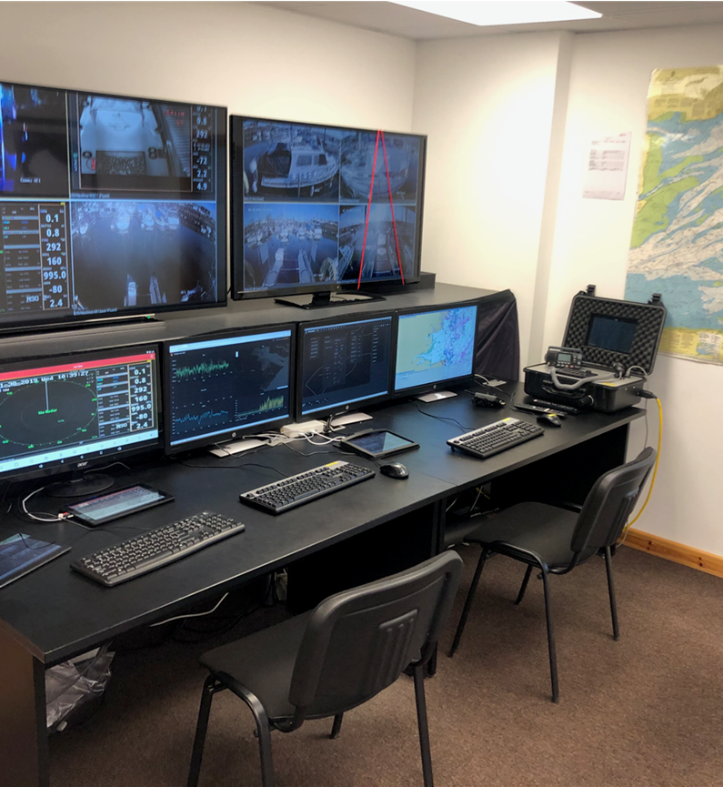
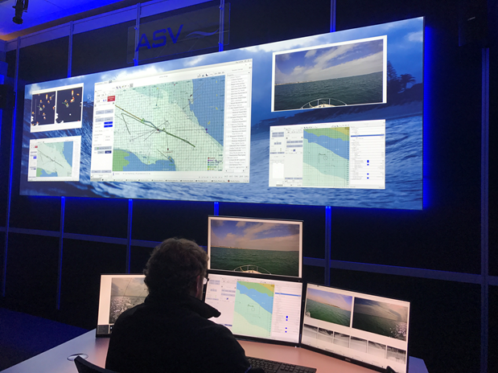
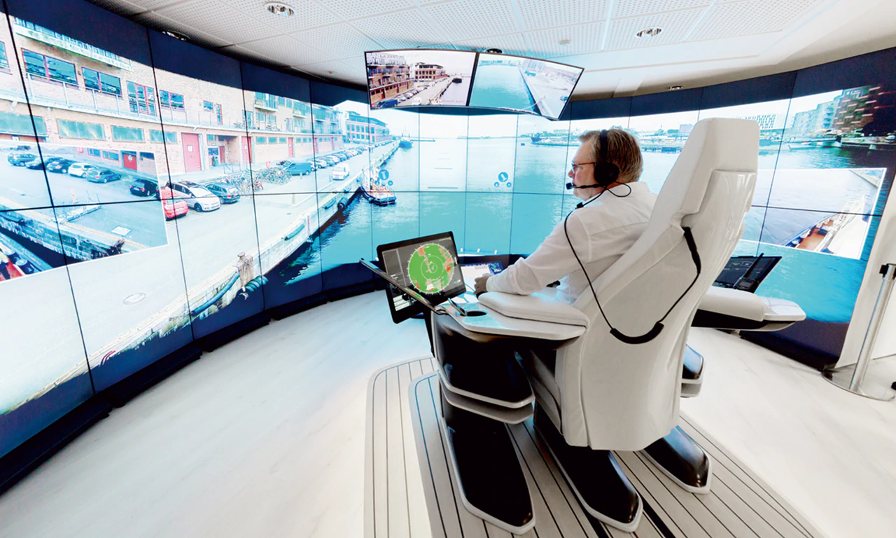
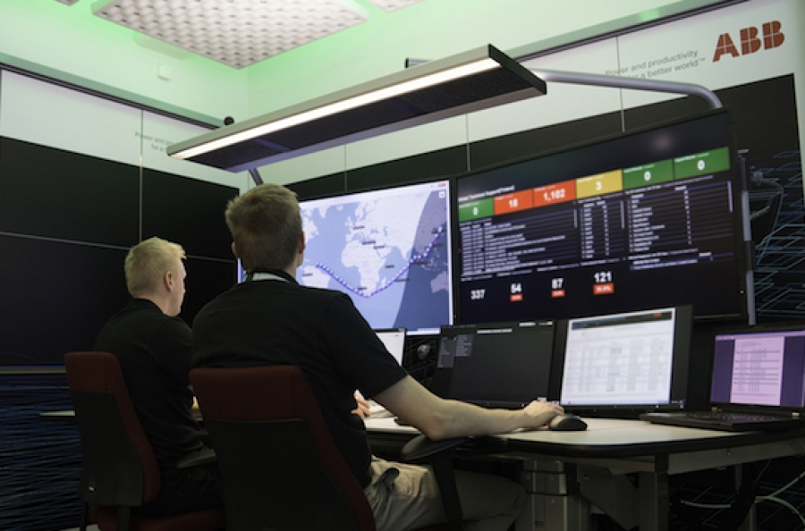
Base Control Stations
SEA-KIT
L3 ASV
ROLLS ROYCE
ABB

Slide 21
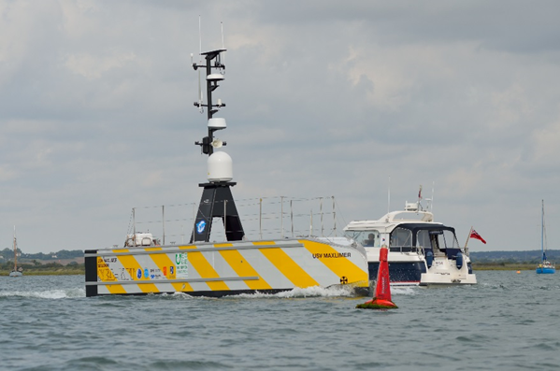
MASS Responsibilities
Responsible Ownership.
Use the guidelines, codes and standards which are available.
Safe Operation.
Recognised Accreditation, Training and Standards.
Effective Integration into the Maritime domain.

Slide 22
Summary
There are sufficient guidelines and relevant standards for the autonomous industry to continue to grow.
IMO must continue their work while the industry develops.
Industry has a vital role to demonstrate responsible attitudes.
We must keep autonomy in perspective and not make assumptions which are not accurate.
‘Autonomous’ ships may switch between modes of operation during voyages.
There will always be a mix of vessels at sea.
Humans are critical.
Safety must come first.

Slide 23
James Fanshawe CBE
james.fanshawe@ukmarinealliance.co.uk
+44 7769 702031
www.maritimeuk.org/media-centre/publications.

