Slide 1
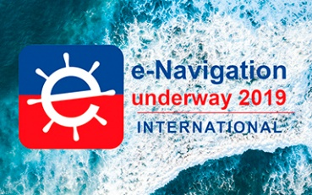
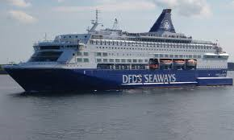
STM and VDES are interlinked regulations and standards
E-Navigation Underway International
6-8 february 2019, Copenhagen-Oslo
Onboard M/S PEARL SEAWAYS
Peter Bergljung
2019-02-06, B
peter.bergljung@saabgroup.com
This document and the information contained herein is the property of Saab AB and must not be used, disclosed or altered without Saab AB prior written consent.

Slide 2
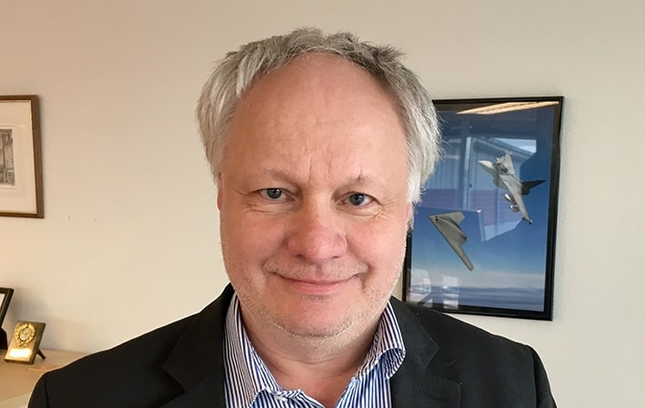
Presenter - Peter Bergljung
M.Sci – Digital Control / Mechatronic engineering 1987, Linköping University
Working 13 years for Saab Dynamics (cruise missile navigation and Gripen C/D integrated navigation)
Working 19 years for Saab TransponderTech.
Currently: Director of Strategy & Portfolio TransponderTech Products
Project Manager STM
Future products
Portfolio Management

Slide 3
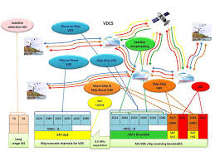

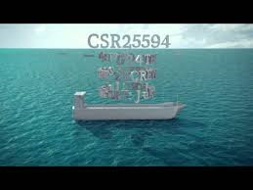
STM and VDES
VDES – Next Generation AIS
E-Navigation and Sea Traffic Management
STM
VDES
VDES & STM are interlinked

Slide 4
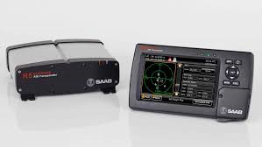
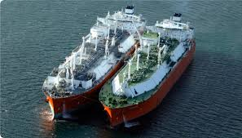
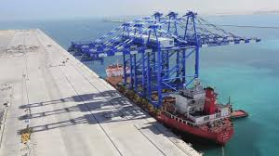
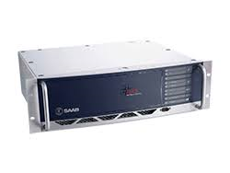
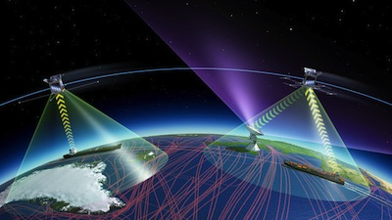
BACKGROUND – What is VDES and AIS
Currently 140,000 merchant ships carry professional AIS Shipborne products (estimated).
Traffic control centres globally can communicate dual way with the shipborne units via base stations.
Saab is a leader in this field with an installed base of >25,000 shipborne units and >2,800 base stations.
AIS has been in operations since year 2002 and VDES will be from ca 2019/2020.
ship-to-ship
Saab Shipborne
ship-to-shore
shore-to ship
Saab Base Station
ship-to-satellite
satellite-to-ship
AIS: Automatic Identification System
VDES: VHF Data Exchange System, next generation AIS

Slide 5
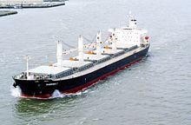
Current ship borne (on board) AIS & DGNSS system
Installed at the ships bridge

Slide 6
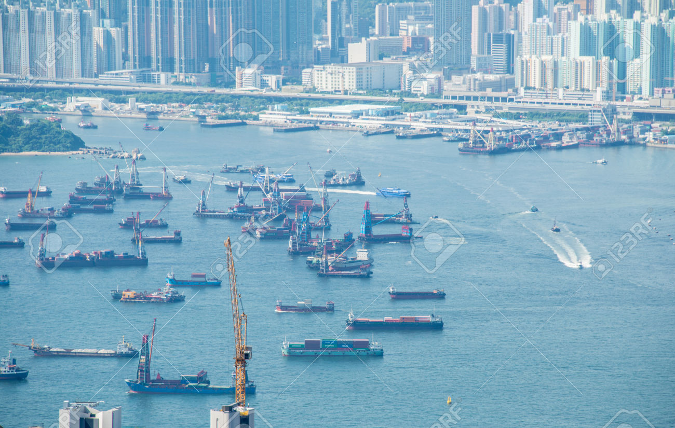
Rationale for VDES
AIS has been successfully introduced by the International Maritime Organization (IMO) for maritime navigation in 2002. Since then, virtually all commercial ships and recreational vessels have been equipped with AIS – world wide.
The expanding use of AIS has already caused a significant load on the capacity of the VHF Data Link (VDL) – its overloaded in some busy areas.
The next generation AIS – internationally called the VHF Data Exchange System (VDES) – will take into consideration the future requirements for more data exchange capabilities. Thereby, the AIS radio channels (VHF Data Link VDL) will be protected from overload as AIS populations increase.
VDES gives up to 32 times more bandwidth compared to AIS and can also provide unique satellite to ship communication.
VDES will be in initial operation from year 2020, and probable in operation beyond year 2040.
Potentials also for replacing significant parts of GMDSS, including NAVTEX, VHF, MF and HF coastal stations.
Busy Hong Kong port

Slide 7
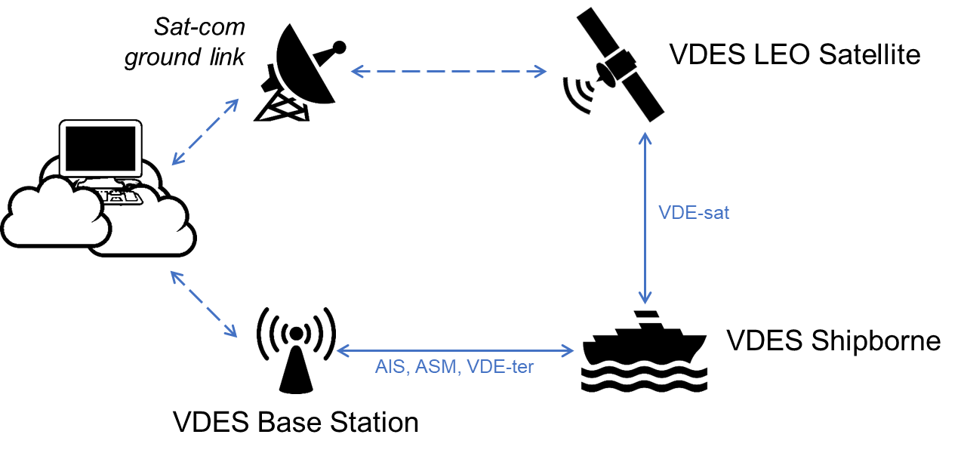
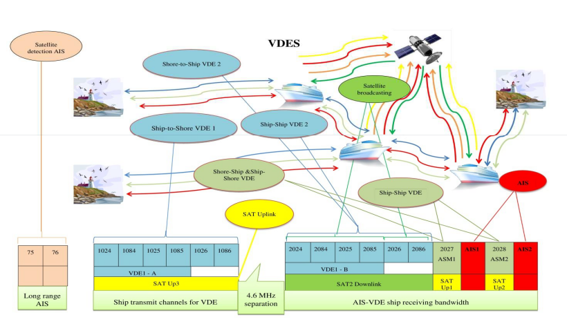
VDES – Next Generation AIS
VDES
AIS
ASM
VDE
Standardisation work on-going for VDES (VHF Data Exchange System), which is required for:
Capacity – increased sea traffic density in busy areas resulting in overload of AIS
Bandwidth – new applications for E-navigation, e.g. Sea Traffic Management (STM) lead by Sjöfartsverket
Automatic Identification System
(2 radio channels)
AIS
Application Specific Messaging
(2 new radio channels)
ASM
VDE VHF Data Exchange (8 new radio channels)
VDE
VDE-ter
Terrestrial link
VDE-sat
Satellite link

Slide 8




What is totally new in VDES compared to ais
Simultaneous reception and transmission for base stations.
Satellite-to-ship world-wide communications.
Up to 32 times more bandwidth compared to AIS.
Base station and shore-network are more integrated for efficient spectrum management. This technology is denoted Bulletin Board services and can be cloud based and adapted for E-navigation /STM.
Better cyber security and integrity
Core VDES international stakeholders

Slide 9
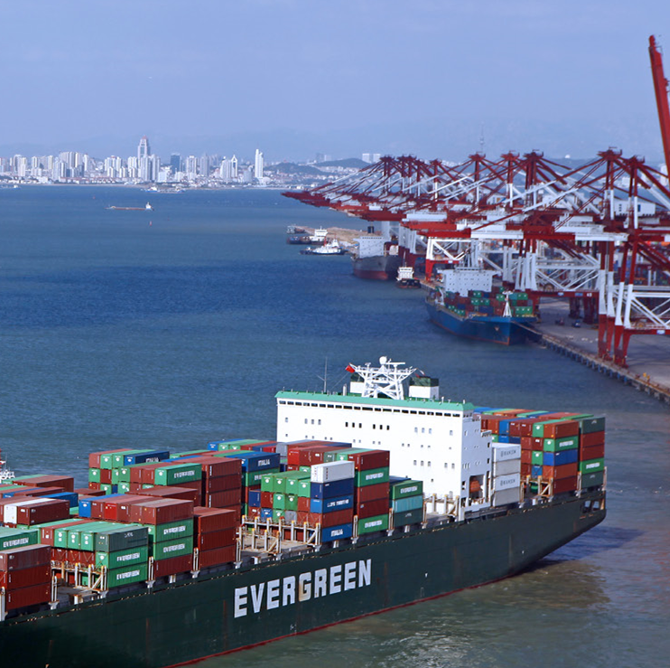
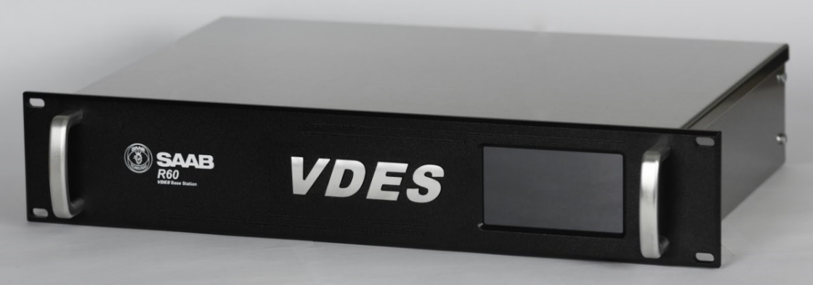
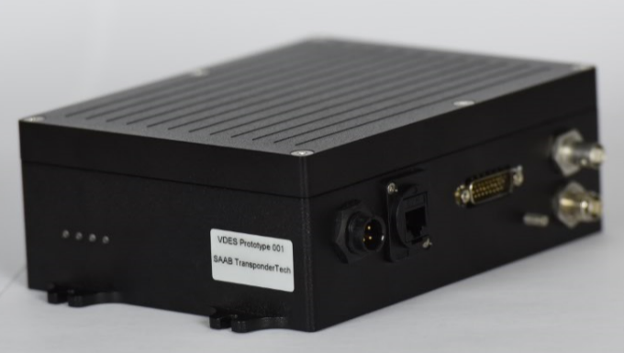
VDES Strategy – Next Generation AIS
Transponder Tech Products shall be Leading in VDES Technology, through:
A complete, certified VDES product portfolio
Active participation in international standardisation work
Innovative new applications such as Sea Traffic Management
Strategy for new VDES (VHF Data Exchange System) portfolio
In addition to AIS, VDES also includes ASM and VDE channels
R60 VDES Modular Base Station
R6 Mobile prototype
Prototype #1
Prototype #2
Serial Production
R60 Base Station ASM & AIS
Prototype #1
Serial Production
R60 Base Station VDE module
Prototype #1
Serial Production
R6 Mobile VDES
2018
2019
2020
2021

Slide 10
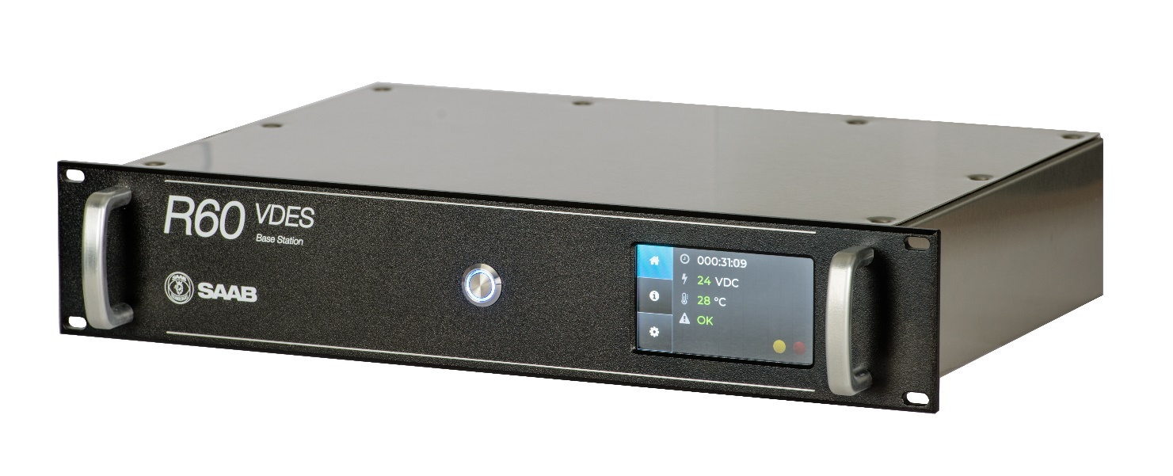
R60 VDES Main Features
VDES
AIS
ASM
VDE
Multi-GNSS capability
GPS
BeiDou
Galileo
Glonass
Extended capacity AIS + ASM channels
Multi interface Cyber Security
Protection, including embedded support for Saab Secure VDES
High bandwidth VDE channels
Legacy interfaces for direct replacement of R40 AIS Base Station
NTP Time Server
Fully compatible with existing AIS Networks
from Saab
Prepared for Rebranding
Touch Screen Colour Display
Future proof design

Slide 11


Cyber Security IN VDES
Defending all three vulnerable group of interfaces:
Cyber Security
Resilient PNT
IP, Serial
& External storage
Secure VDL
PNT – Positioning, Navigation and Timing using the GNSS antenna.
VDL – VHF Data Link, i.e. AIS and VDES, using the VHF antenna.
IP, Serial – Internet Protocol and Serial connections using Ethernet and serial traffic (e.g. IEC61162)
External storage – USB, memory cards etc.

Slide 12
VDES Main global Challenges
Activity | Main responsible
No mandatory SOLAS chapter V change plans from AIS to VDES yet. Without mandatory decisions, world-wide implementation and installations of shipborne VDES will take significantly longer time. | IMO MSC
Sat-VDES needs frequency allocation for downlink at WRC-19 (November 2019). Without these frequencies the over-the-horizon dual way communication will be delayed at least four years to WRC-23 or completely be abandoned. | ITU WRC-19 & Regional/Country representatives
Test houses (Competent Bodies) and test standards needs to be finalized. | Competent bodies, IEC and Industry
Design to cost, production and installation efficiency | Industry
Develop new services. For example STM route exchange. | Shipping Community

Slide 13
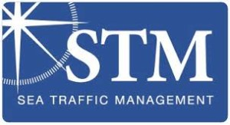
E-Navigation and Sea Traffic Management
STM will most probable be the future of e-Navigation and game-change the way sea traffic management (ship-ship, ship-shore-port) will be handled in the future.
STM is probably the largest e-Navigation project in the world with soon over 300 sailing ships (currently 215) and connecting 13 ports and six shore centers.
39 partners cooperate with a joint budget of 43 million euros. Associated Partners of STM is currently 49 companies or organisations. More associated partners joins every quarter.
STM is about sharing and coordination of information with routes as its core for optimizing sea traffic with cloud and big-data technology – for all stakeholders.
In total 75 million euros has been
Invested in the STM technology,
by EU and partners.

Slide 14
Organization(s) involved in STM
Beneficiary partners:
Swedish Maritime Administration (lead partner), Airbus, Carnival Corporation, Chalmers, CIMNE, Costa Crociere, Cyprus University of Technology, Danish Maritime Authority, Finnish Transport Agency, Flensburg University of applied sciences, Fraunhofer, Frequentis, Furuno, GS1, HiQ, Magellan, Maritiem Instituut Willem Barentsz, Ministry of Infrastructure and Transport in Italy, Navicon AS, Norwegian Coastal Administration, Novia University of Applied Sciences, OFFIS, Polytechnical University of Catalonia, Port Authority of Valencia, Port of Barcelona, RISE Viktoria, Rörvik Maritime Safety Center, SAAB, Sasemar, Southampton Solent University, SSPA, Svitzer, SMHI, Transas, University of Oldenburg, University of Southhampton, Valenciaport Foundation and Wärtsilä SAM-Electronics.
Associate Partners (**1)
Port of Gothenburg, Kvarken Ports, Ericsson, Cygate, Raytheon, Kongsberg Maritime, UK Hydrographic Office, BIMCO, SSAB, Rheinmetall, INTTRA, Carmenta, Adveto, Navtor, Seamless / Grieg Logistics, Janz Tec, University of Applied Sciences Emden/Leer - Faculty of Maritime Studies, Fleet Management Limited, Fleetrange, Tototheo Group, JRC (Japan Radio Company), Marine Fields, Urban Hawk, SMART Navigation, Vopak, Lloyds Register, Rocket Brothers, Vissim, Latvian Maritime Academy , Maritime Campus North (NORD University), Novikontas, Marine Institute of Memorial University of Newfoundland , DFDS, Rolls-Royce, Utkilen, Wallenius Marine, Dalex Shipping, NAPA, Estonian Maritime Academy, VTT Technical Research Centre of Finland, ÅF Digital Solutions, Sperry Marine, ChartWorld, Offshore Navigation, Indra and MeriTaito.
**1) As of October 2018

Slide 15
STM Cooperation projects
Smart Navigation Project (ongoing)
EfficienSea 2 project (finalized)
International Taskforce on Port Call Optimisation (ongoing)
Sesame Straits project II (ongoing)

Slide 16
History of STM
”STM journey started as MTS (Maritime Traffic System) in 2007-2010. A small research project: Saab TransponderTech, Chalmers Maritime University and SMA. We funded and inaugurated our Gothenburg demo site during this project (still in operation).
MONALISA project was started 2010.Seven project members. 2010-2013. Saab had the industry lead. Presented the concept at IMO London in may 2012.
MONALISA 2. 15 project members. Without Saab. 2013-2015. Transas (now Wärtsilä) had the industry lead.
STM Validation Project – current project. 39 partners and more then 45 associates. No indvidual company has the lead – STM is an eco-system-driven project, and SMA has a main role (lead partner) and run the project as a ”standardisation project” aiming for IMO MSC and SOLAS.
SMA : Swedish Maritime Administration
IMO MSC: IMO Maritime Safety Commitee

Slide 17
STM introduction
Sea Traffic Management (STM) is an answer to the need for improved efficiency in maritime transport; within port clusters as well as between ports.
The STM concept takes a holistic view on services within shipping, from quay to quay.
STM is a concept for optimizing the processes, interaction between stakeholders and exchange of information.
Improved exchange of information is an important facilitator for increased situational awareness and thereby improved safety of navigation.
STM has already showed great socio-economic benefits as well as business cases for the industry, i.e. by saving of bunker, decreased emissions from shipping, improved utilization of resources and improved maritime safety, not least in congested waters.
When implemented, Sea Traffic Management will be the most efficient cost reducing innovation brought forward in maritime industry since the AIS.

Slide 18
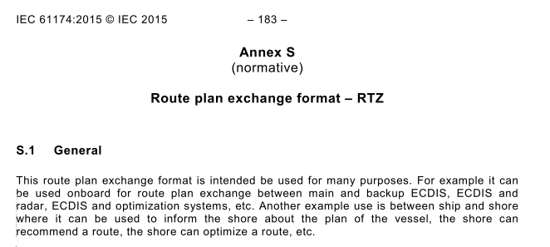
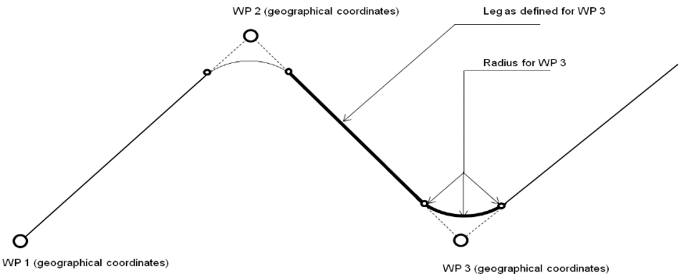
STM route exchange
STM route exchange
STM project developed the exchange protocol for onboard routes (RTZ). Source IEC 61174 Ed.4.0:2015 .
STM project also developed close quarter routes for transmission over AIS & VDES as BBM (Binary Broadcast Messages). Saab took lead in this work.
RTZ and AIS/VDES BBM work coherent. When the ship start saling the route (called the monitored route) then the onboard ECDIS send the close quarter route to AIS/VDES in accordance with a proposed standard developed in the STM project.
The route can be optimized onboard or on-shore before entering into ”monitored mode” by different stakeholders. RTZ is the exchange format.
Optimization criterias can be ETA in cooperation with the port and fuel consumption optimization (wind, sea current, squat effects etc).
Monitored Route: Active Route
ETA: Estimated Time of Arrival
Squat effect is a hydrodynamic phenomenon that will significantly increase drag in shallow water
and reduce under keel clearance. Squat effects increase with speed and in confined channels.

Slide 19
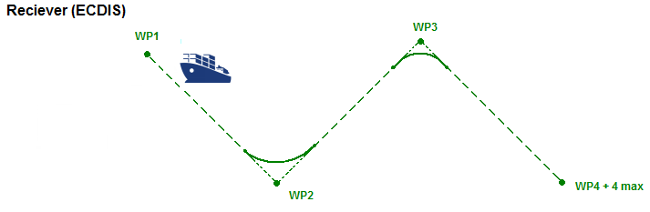
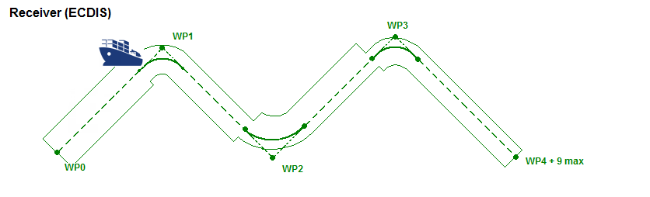
MAIN Difference between AIS and VDES binary messages structue
AIS can represent 7 legs maximum
VDES can represent 13 legs maximum
VDES can also represent XTD port side and starboard
AIS cannot represent XTD port side and starboard, due to bit-restrictions.
AIS
Other parameters in the structure for each leg
(derived from RTZ or internal ECDIS format)
Leg geometry (Rhumb line or Great Circle)
Planned Speed over ground
Turn radius
Steering mode (Manual, Heading control, Track control)
VDES
XTD : Cross Track Distance
Reference: STM Route Message System Requirements, F1, 2017-10-13

Slide 20
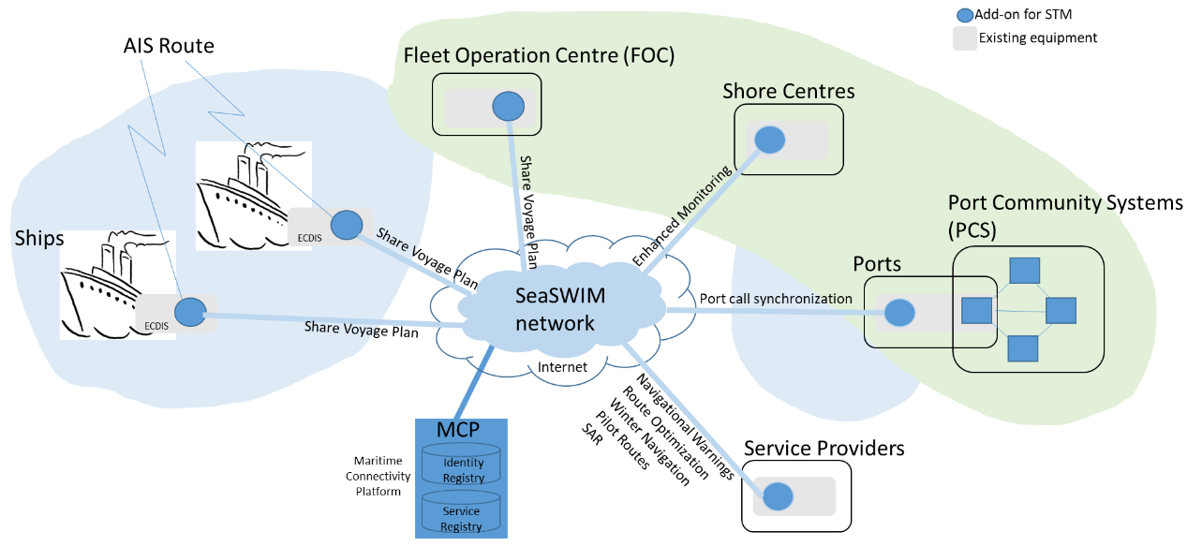
STM introduction cont.
STM Live testbed
Saab Shore Center
Gothenburg
The technical architecture is a service oriented architecture with REST services and secure HTTP (HTTPS, TCL and X.509 certificates) for exchange of information through services. Identities and services are registered in the MCP through a web portal, and certificates are also issued through the MCP web portal.
The set of common message formats used are; Route Exchange Format (RTZ), Navigational Warnings (S-124), Port Call Message Format (PCM) and STM text message format (TXT). The set of common service interfaces used are: Voyage Information Service for RTZ, S-124 and TXT, and AMSS+MB for PCM.
IEC WG 17 is now developing the predecessor to RTZ; the S-421 Route Plan based on S-100. It’s a three year journey before CDV and a standard. Until then use, RTZ.

Slide 21
Current STM Service types
Route Cross-check
Route Optimisation
Ship to Ship Route Exchange
Navigation Warnings
Enhanced Monitoring
Port Call Synchronisation/Optimisation
Winter Navigation
Importing Pilot Routes
Search and Rescue
This can expand to many more areas
See more on: http://stmvalidation.eu/
”STM and SeaSWIM is E-Navigation”
SeaSWIM is the ”app store” for
E-navigation services
– thousands of maritime services is envisioned
(now we have ca 20 services from 20 companies)

Slide 22
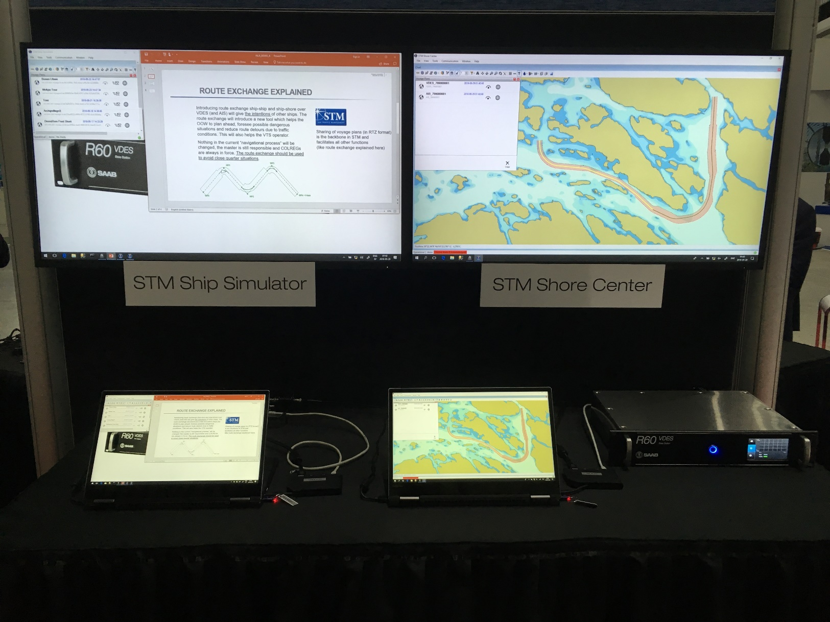
STM/DEMO SETUP FROM IALA Incheon Conference 2018
Showing route exchange
AIS and VDES
STM Enhanced monitoring
and warnings

Slide 23
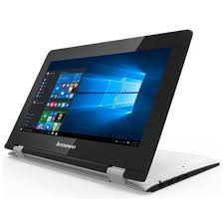
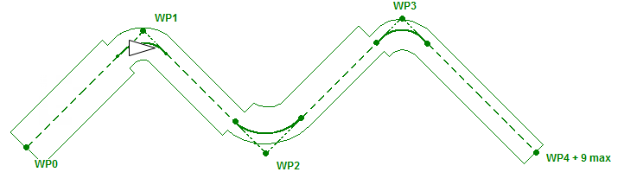
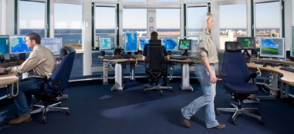
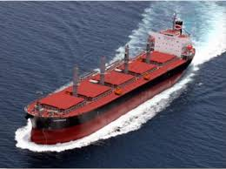
SAAB IALA VDES/STM DEMO SETUP
Ship R6
VDES
VHF radio signal in coaxial cable
R60 VDES
Base Station
Route exchange
over VDES.ASM (and AIS)
STM
ECDIS
RTZ
STM
Shore Center
Voyage plans
RTZ
SeaSWIM
Internet
Internet
STM Enabled Ship
2018-05-23
IALA DEMO, rev A

Slide 24
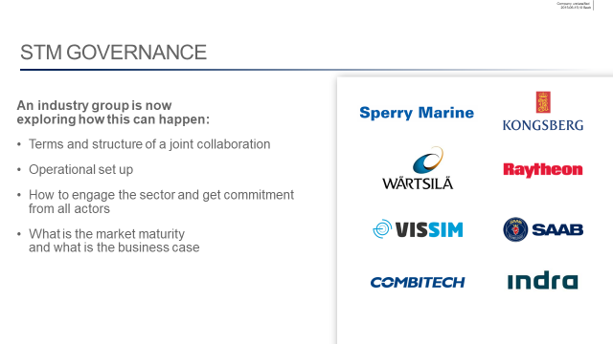
Conclusions about STM and VDES
Efficiency, safety, security and environmental protection of shipping will be enhanced with VDES and STM interlinked.
STM Governance has to be in place after STM project ends in June 2019.
More STM partners outside Europe has to be involved.
VDES has some main global challenges, that needs to be addressed by the stakeholder (see page 11) including the mandatory challenge in SOLAS.
Thank You!

