Slide 1
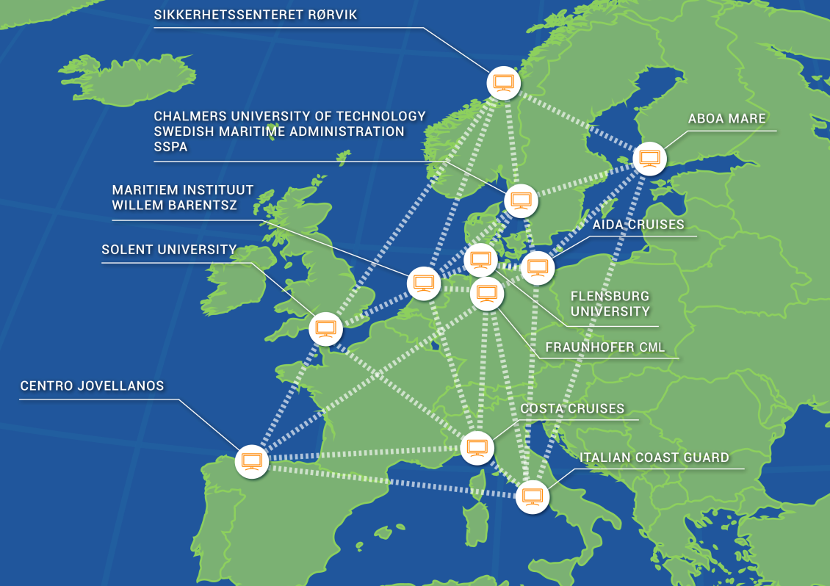


EMSN: virtual large-scale test facility for e-Nav/ship autonomy development
Dipl.-Wirtsch.-Ing. Univ. Hans-Christoph Burmeister
07.02.2019 – e-Navigation underway

Slide 2
Agenda
EMSN Motivation
STM Validation Act. 3
EMSN-Connect
Outlook
Notes:
MONALISA 2.0 is an European TEN-T project that aims at contributing to a continuous improvement and development of efficient, safe and environmentally friendly maritime transport by implementation of a series of measures in accordance with the EU's transport policies. Amongst others, this includes developing several operations and tools towards the deployment of future sea traffic management.
As a trial area, a joint network of different ship handling simulations centres in Europe, the “European Maritime Simulator Network EMSN”, will be established. The EMSN shall serve as a macro simulation environment to test and verify the feasibility and benefits of the developed MONALISA operations. While EMSN’s main purpose within MONALISA is to study the effect of “Route Exchange” and “Sea Traffic Coordination Centre” on safety, environment and efficiency, the EMSN itself is a sustainable investment in connecting ship handling simulators to a Distributed Interactive Simulation environment that provides long-term opportunities with regards to e.g. Formal Safety Assessments even beyond MONALISA. The presentation will give a short overview about the scope and possibilities of the EMSN as well as the technical background to illustrate EMSN’s role and capabilities within the MONALISA 2.0 test-bed.

Slide 3
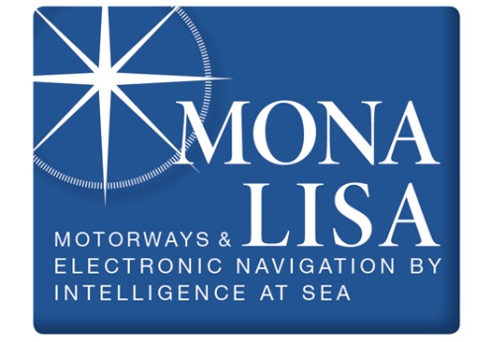

EMSN Motivation
Concept requires cost-efficient large-scale validation
Concept development
Voyage planning process
Ship-to-shore-route exchange
STM route optimization
STM active traffic monitoring
Concept validation
HMI and operations test
Large-scale evaluation test
Final demonstration

Slide 4
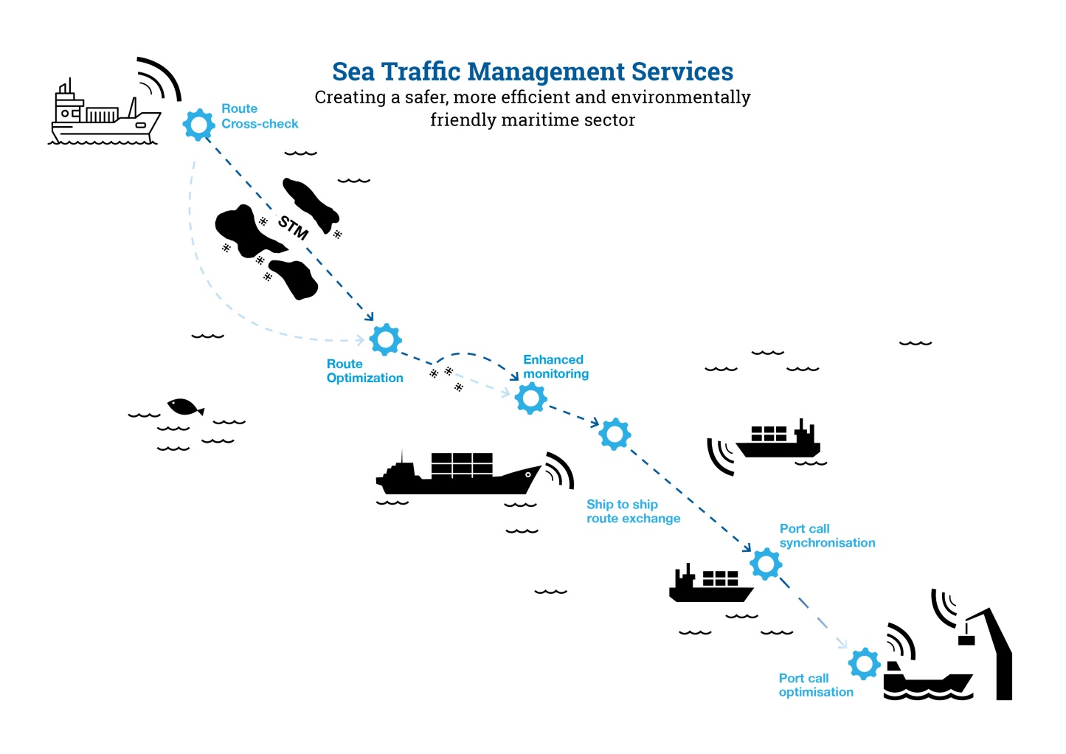
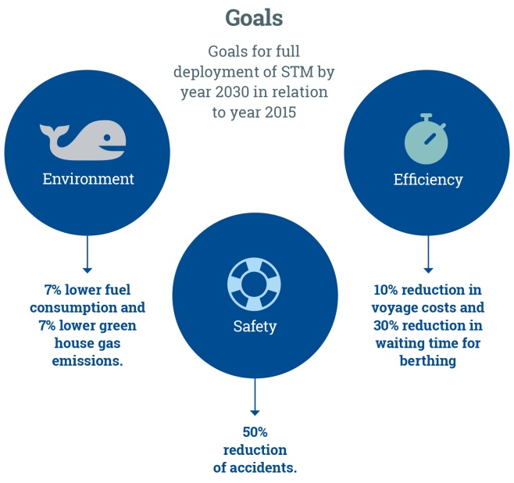
EMSN Motivation
Services according to the STM Validation project

Slide 5
Today‘s approach: New TSS in iWrap MkII (Example)
Method useful for geometrical changes
Step 2
Risk
Assessment
Step 2
Risk
Assessment
We know how geometry changes!
Risk = Collision Candidates x Causation Factor x Consequence

Slide 6


Today‘s approach: STM in iWrap MkII (Example)
Organisational changes hard to assess by suggested methods
Step 2
Risk
Assessment
Step 2
Risk
Assessment
Step 2
Risk
Assessment
???
We hardly know how humans behave!
Risk = Collision Candidates x Causation Factor x Consequence

Slide 7
EMSN Motivation
Several SHS available in the EU, but only internal connected
Enough simulators available, but integration is missing
  Swedish Maritime Administration
  Chalmers University of Technology
  Fraunhofer CML
  Carnival Corporation
  AIDA
  Centro Jovellanos
Involvement of manufactures
  TRANSAS
  Rheinmetall
  Kongsberg
Create a virtual ocean
European Maritime Simulator Network

Slide 8
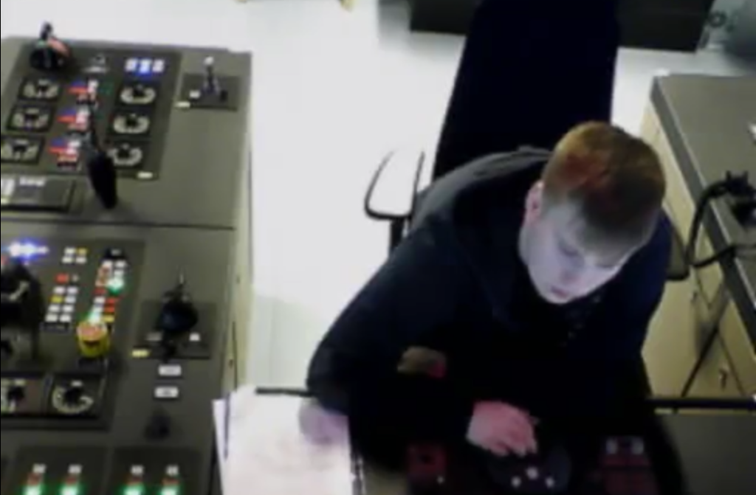
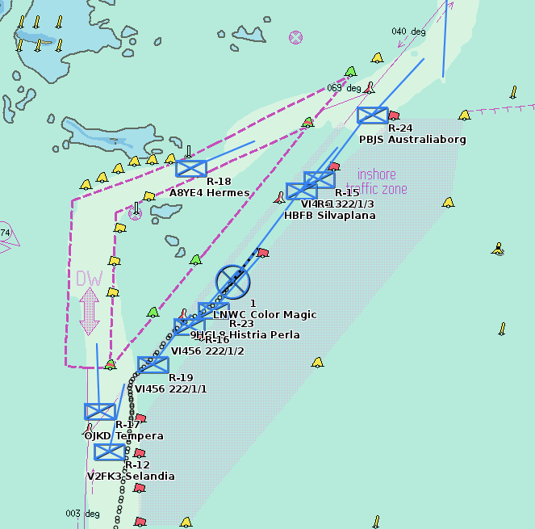



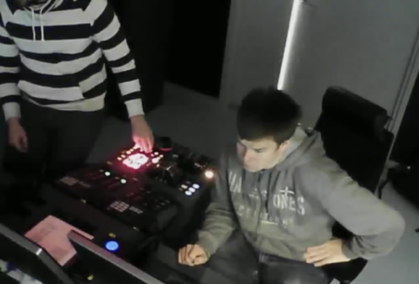

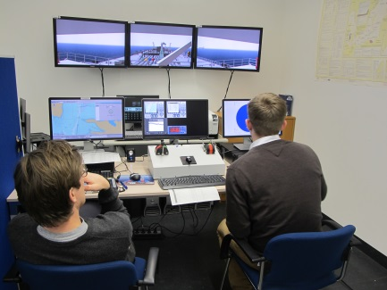

EMSN Motivation
First full-scale tests held in December 2014 with 13 Own-ships

Slide 9
Agenda
EMSN Motivation
STM Validation Act. 3
EMSN-Connect
Outlook
Notes:
MONALISA 2.0 is an European TEN-T project that aims at contributing to a continuous improvement and development of efficient, safe and environmentally friendly maritime transport by implementation of a series of measures in accordance with the EU's transport policies. Amongst others, this includes developing several operations and tools towards the deployment of future sea traffic management.
As a trial area, a joint network of different ship handling simulations centres in Europe, the “European Maritime Simulator Network EMSN”, will be established. The EMSN shall serve as a macro simulation environment to test and verify the feasibility and benefits of the developed MONALISA operations. While EMSN’s main purpose within MONALISA is to study the effect of “Route Exchange” and “Sea Traffic Coordination Centre” on safety, environment and efficiency, the EMSN itself is a sustainable investment in connecting ship handling simulators to a Distributed Interactive Simulation environment that provides long-term opportunities with regards to e.g. Formal Safety Assessments even beyond MONALISA. The presentation will give a short overview about the scope and possibilities of the EMSN as well as the technical background to illustrate EMSN’s role and capabilities within the MONALISA 2.0 test-bed.

Slide 10

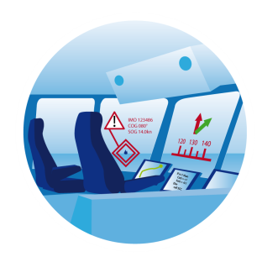
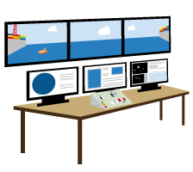

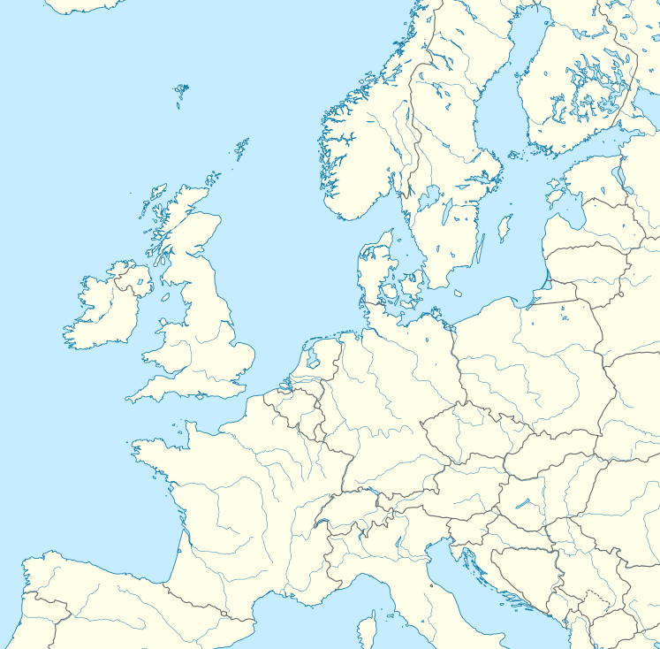

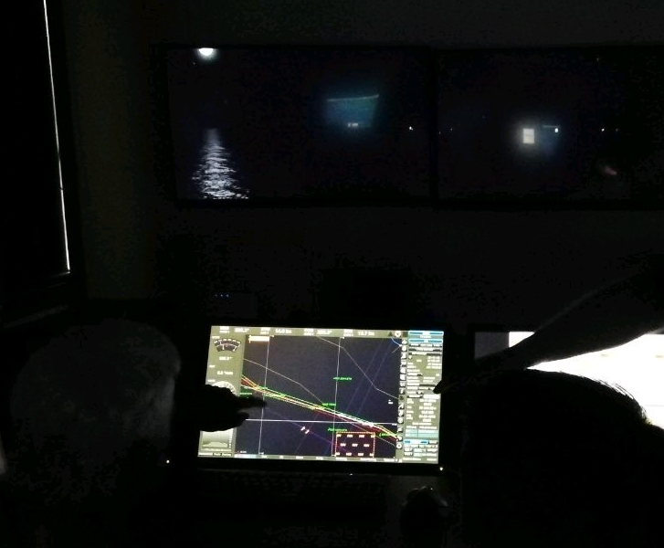
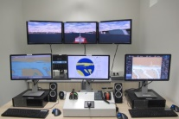
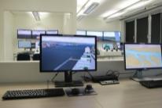
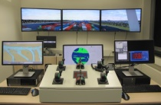





STM Validation Act 3
European Maritime Simulator Network
MCP
NMEA
Sikkerhetssenteret Rørvik
NordLab
Nord University
Aboa
Mare
Chalmers
University
Swedish Maritime Administration
Flensburg
University
Maritime Accidents
New
Warsash Marine Academy
Willem
Barentsz
Fraunhofer CML
Emden-Leer University
Avoided
Centro
Jovellanos
Universitat Politècnica de Catalunya
12 Centers | 3 Manufacturer | 30+ Bridges

Slide 11
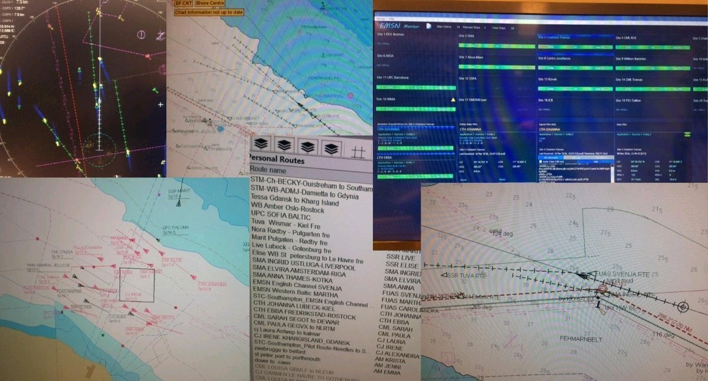
STM Validation Act 3
Full-scale tests held in 2017/2018 with up to 30 Own-ships

Slide 12

STM Validation Act 3
Technical background
STM Comm. Infrastructuere
STM-Equipment
NMEA AIS
Kongsberg
SHS
DIS Interf.
EMSN Router
EMSN Hub
Voice Communication
STM-Equipment
NMEA AIS
Rheinmetall
SHS
DIS Interf.
EMSN Router
Voice Communication
STM-Equipment
NMEA AIS
Transas
SHS
DIS Interf.
EMSN Router
Voice Communication
Act 2 / Act 4
Act 3 EMSN
Act 3 EMSN

Slide 13
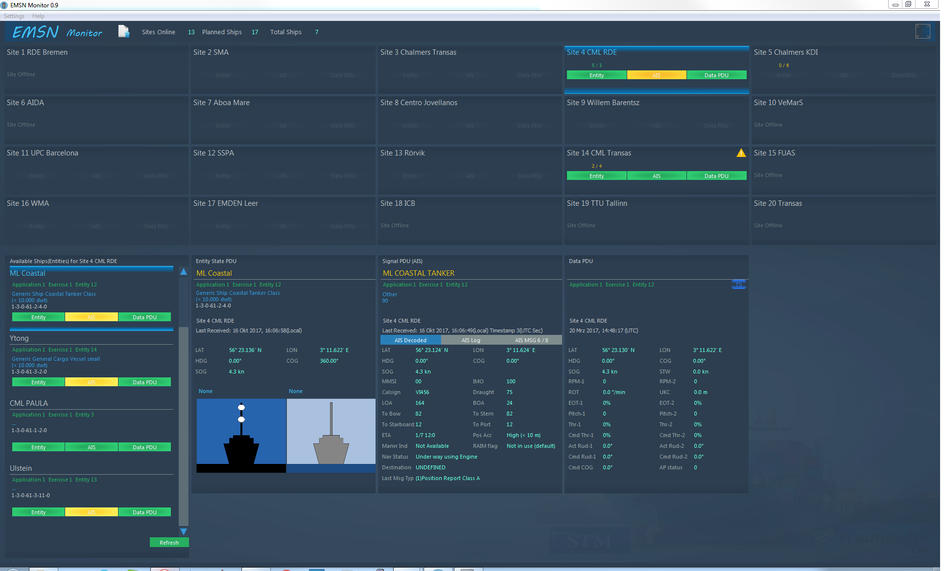

STM Validation Act 3
Data Tracking and Network tracing from the EMSN Monitor

Slide 14
Agenda
EMSN Motivation
STM Validation Act. 3
EMSN-Connect
Outlook
Notes:
MONALISA 2.0 is an European TEN-T project that aims at contributing to a continuous improvement and development of efficient, safe and environmentally friendly maritime transport by implementation of a series of measures in accordance with the EU's transport policies. Amongst others, this includes developing several operations and tools towards the deployment of future sea traffic management.
As a trial area, a joint network of different ship handling simulations centres in Europe, the “European Maritime Simulator Network EMSN”, will be established. The EMSN shall serve as a macro simulation environment to test and verify the feasibility and benefits of the developed MONALISA operations. While EMSN’s main purpose within MONALISA is to study the effect of “Route Exchange” and “Sea Traffic Coordination Centre” on safety, environment and efficiency, the EMSN itself is a sustainable investment in connecting ship handling simulators to a Distributed Interactive Simulation environment that provides long-term opportunities with regards to e.g. Formal Safety Assessments even beyond MONALISA. The presentation will give a short overview about the scope and possibilities of the EMSN as well as the technical background to illustrate EMSN’s role and capabilities within the MONALISA 2.0 test-bed.

Slide 15
Overview
Scope of EMSN-Connect
Maintain current EMSN
New Centers
New EMSN Functionalities
Extend DIS functionalities
Maintain status quo of DIS Proxy also after updates
Offer DIS Proxy to new centers joining

Slide 16
EMSN-Connect
When should you be interested?
Do you want to
Maintain connectivity beyond STM-V
Use EMSN Simulations as part of research proposals
Use EMSN for ordinary training purposes (students, refresher as well as SAR)
EMSN-Connect allows all partners to continue using EMSN with keeping the administrative costs low for everybody

Slide 17
EMSN-Connect
Use Case training: Only existing technology required
NMEA AIS
Kongsberg
SHS
DIS Interf.
EMSN Router
EMSN Hub
Voice Communication
NMEA AIS
Rheinmetall
SHS
DIS Interf.
EMSN Router
Voice Communication
NMEA AIS
Transas
SHS
DIS Interf.
EMSN Router
Voice Communication

Slide 18
EMSN-Connect
Partners participating
Sikkerhetssenteret Rørvik
NordLab
Nord University
Aboa
Mare
Chalmers
University
Flensburg
University
Willem
Barentsz
Fraunhofer CML
Centro
Jovellanos
8 (+2) Centers | 3 Manufacturer | 21+ Bridges

Slide 19
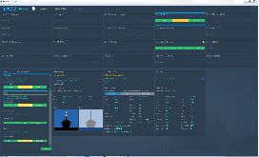
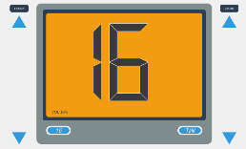
EMSN-Connect
Technical Coordinator Tasks
EMSN
Network Stability and Development
  Server hosting
  Node Connection
  TeamSpeak Licences
  EMSN Technical Specification Maintenance
Technical Consultancy
  EMSN Monitor
  EMSN Data Tracker
  VHF Client
Joint Exercise Hosting
  3 Campaigns per year
  EMSN Exchange Event
  Availability for third party projects
Technical Coordinator
The EMSN is free to use for all partners for further own simulations

Slide 20
Agenda
EMSN Motivation
STM Validation Act. 3
EMSN-Connect
Outlook
Notes:
MONALISA 2.0 is an European TEN-T project that aims at contributing to a continuous improvement and development of efficient, safe and environmentally friendly maritime transport by implementation of a series of measures in accordance with the EU's transport policies. Amongst others, this includes developing several operations and tools towards the deployment of future sea traffic management.
As a trial area, a joint network of different ship handling simulations centres in Europe, the “European Maritime Simulator Network EMSN”, will be established. The EMSN shall serve as a macro simulation environment to test and verify the feasibility and benefits of the developed MONALISA operations. While EMSN’s main purpose within MONALISA is to study the effect of “Route Exchange” and “Sea Traffic Coordination Centre” on safety, environment and efficiency, the EMSN itself is a sustainable investment in connecting ship handling simulators to a Distributed Interactive Simulation environment that provides long-term opportunities with regards to e.g. Formal Safety Assessments even beyond MONALISA. The presentation will give a short overview about the scope and possibilities of the EMSN as well as the technical background to illustrate EMSN’s role and capabilities within the MONALISA 2.0 test-bed.

Slide 21
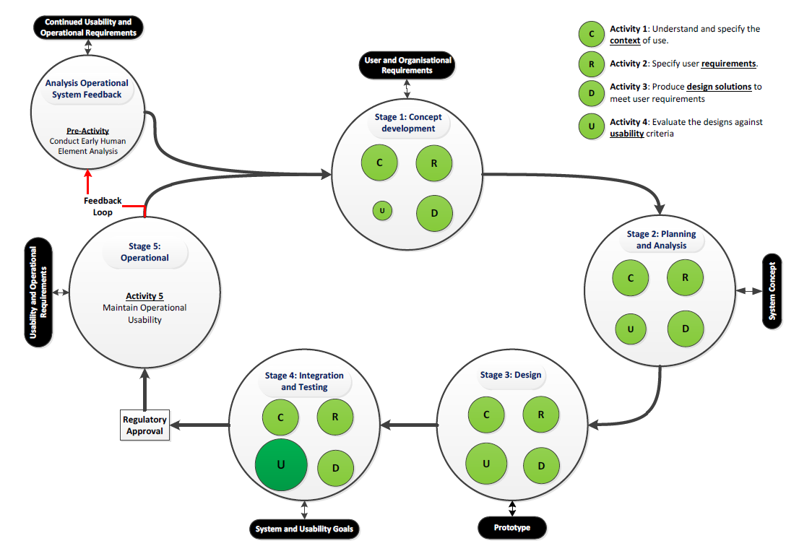
Outlook
Software Life Cycle (HCD) for e-navigation systems
Reference: IMO MSC.1-Circ.1512

Slide 22
Outlook
Relevance of SHS for human factors
Fatigue,
Inadequate communications,
Inadequate general technical knowledge,
Inadequate knowledge of own ship systems,
Poor design of automation,
Decisions based on inadequate information,
Faulty standards, policies or practices and
Poor maintenance
SHS exercises is “the only way to ensure that technical ship handling and the important human factors, are sufficiently incorporated” (PIANC 121-2014)
Hum4n
ErrorR
Human element is related to 60-95% of all accident statistics
Reference: (Sanquist 1992 & Rothblum n.d)

Slide 23
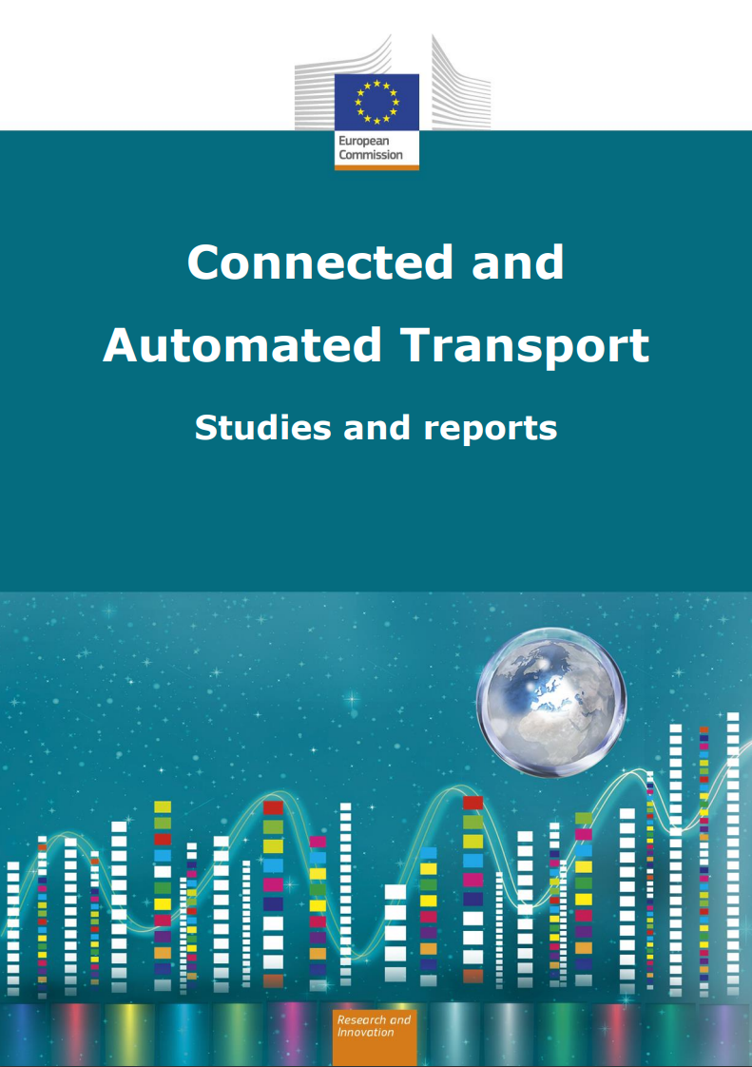
Outlook
Acknowledgement on EU level
“Large-scale test facilities for autonomous vessels: Large-scale test facilities (in situ through assigned sea areas as well as virtually via EMSN) are major gaps with regards to development of safe waterborne CAT. This can be done on regional or EU level with some public funding”

Slide 24
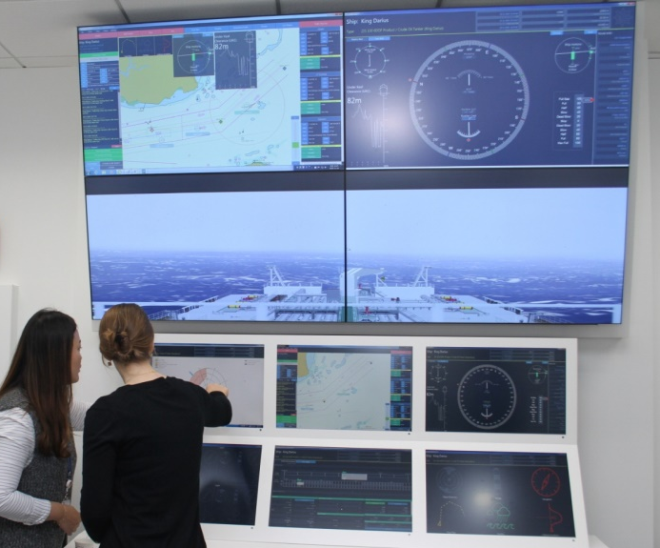
Outlook
MASS integration in EMSN for large-scale studies feasible
AMQP
NMEA
Sikkerhetssenteret Rørvik
NordLab
Nord University
Aboa
Mare
Chalmers
University
Flensburg
University
Maritime Accidents
New
Willem
Barentsz
Fraunhofer CML
Avoided
Centro
Jovellanos
8 (+2) Centers | 3 Manufacturer | 21+ Bridges

Slide 25
Conclusion
EMSN-Connect is a tool for modern, connected training of mariners
EMSN technology provides a unique answer to properly incorporate human factor aspects into marine technical and organisational innovation projects
EMSN shall become a European Large Scale Research Infrastructure for maritime
Compared to technical development, proper funding of profound safety analyses remains a challenge

Slide 26
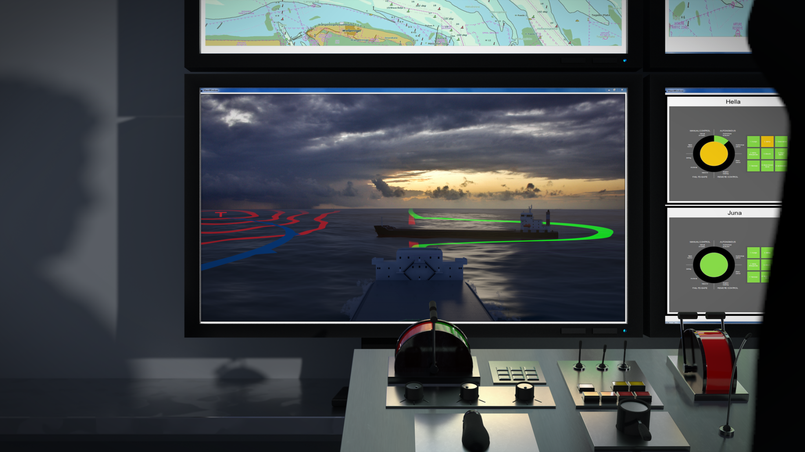
Thank you for your attention
STM Validation received funding by the EU
Fraunhofer CML
Hans-Christoph Burmeister
+49 40 42878 6131
hans-christoph.burmeister@cml.fraunhofer.de

