Slide 1
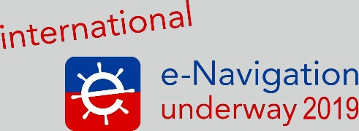
The first e-Navigation testbed in Russia «Hermitage»: subtotals
Marat Ismagilov
Head of the testbed «Hermitage»
Director of Cartography and Hydrography Department
"Kronstadt Group“ (St. Petersburg, Russia)

Slide 2










About «Kronstadt Technologies» (JSC)
Kronstadt Group (includes JSC "Kronstadt Technology") is a Russian high-tech, IT and engineering company specializing in research, design, manufacturing and integration of advanced technology products and solutions for air, marine and ground vehicles and installations. We strive to provide key elements for better performance, safer operations and more efficient personnel training. Kronstadt Group has more than 1300 employees (65% - engineers).
Kronstadt Group (until 2015 - part of Transas Group) has been operating in this market for more than 25 years. Now we are part of the largest Russian financial corporation – «SISTEMA» (SYSTEM) .
«Kronstadt Technologies» is the only Russian technology company to have become a member in IALA association.
«Kronstadt Technologies» is a contractor for developing business road map e-Navigation in MARINET by the order of NTI of Russia.
2500 m²
Overall area of office space
500 m²
Manufacturing area
More than 800 m²
of warehouse
More than
430
employees
25% Development engineers
45% Software engineers
10% Managers
20% Designers

Slide 3
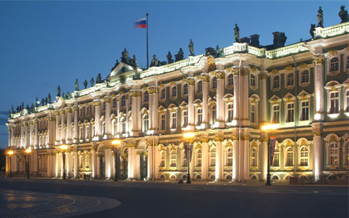
The second stage of development testbed “Hermitage”
In 2016 we started creating the first testbed e-Navigation in Russia.
Now the second stage of the testbed's development is taking place.
This work is performed by the Kronstadt Group in cooperation with our partners.
Customers - Ministry of Transport of Russia and, in the future, MariNet Group (from the National Technological Initiative of Russia).
Research and development (R&D) name: “e-Sea”.
Implementation period – 2016-2021.
The name of testbed - "Hermitage" (in honor of the famous museum in St. Petersburg).
Testbed includes the marine and the river segments.
The State Hermitage Museum,
Saint Petersburg, Russia

Slide 4
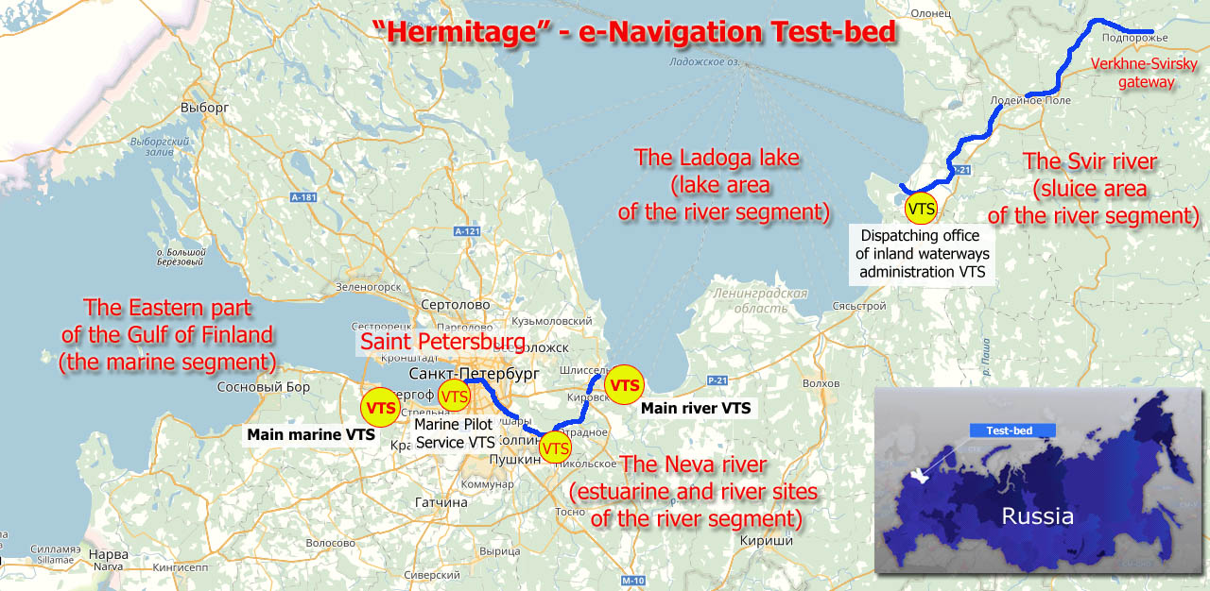
Borders of testbed “Hermitage” in Russia

Slide 5
Implementing e-Navigation in Russia
The ways of implementing e-Navigation in Russia
Federal target program "GLONASS"
State program "National Technology Initiative"
State program "Digital Economy of the Russian Federation"
Future Federal target program "GLONASS"
Ministry of Transport
Working group
"MariNet“
Ministry of Transport, Federal Agency for Maritime and River Transport
Ministry of Transport
R&D "e-Sea“
R&D "e-NAV“
Departmental project "Digital transport and logistics“
R&D "e-Sea non-SOLAS“
2016-2020
2019-2021
2019-2024 (2050)
2021-2024
Accepted, functioning
Accepted, but not yet launched
Not yet approved
Not yet approved

Slide 6
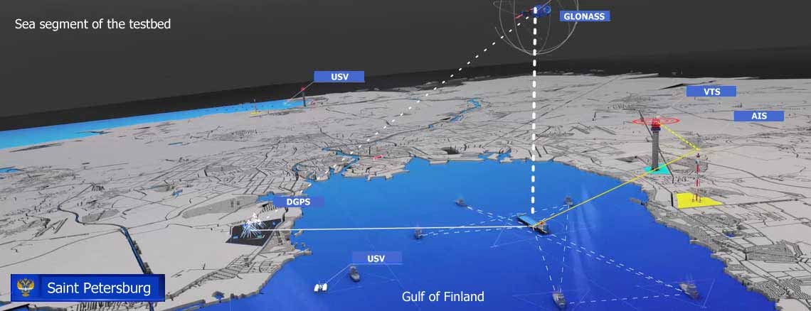
Infrastructure of the Marine segment
VTS - vessel traffic service
AIS - automatic identification system
DGPS - differential global positioning system
ECDIS - electronic chart display and information system
USV - unmanned surface vehicles (in perspective)

Slide 7
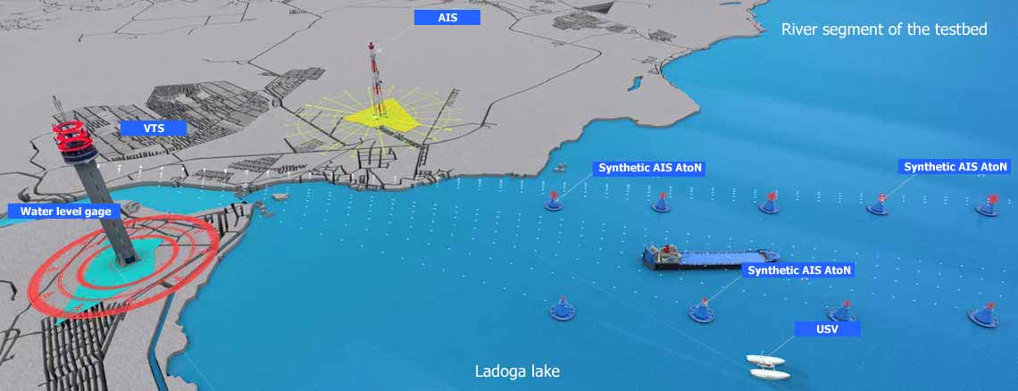
Infrastructure of the River segment
VTS - vessel traffic services on inland waterways
AIS - automatic identification system
Synthetic AIS AtoN (Aids to Navigation)
ECDIS - electronic chart display and information system
USV - unmanned surface vehicles
Water level gage

Slide 8
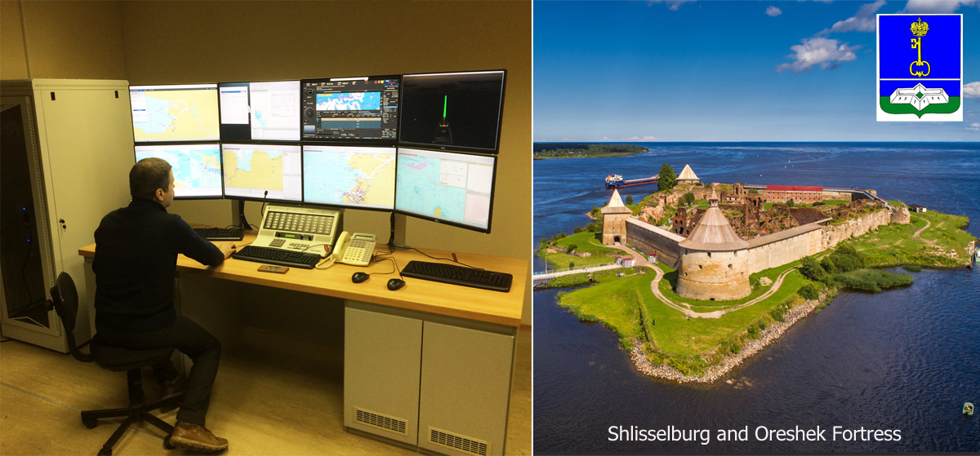
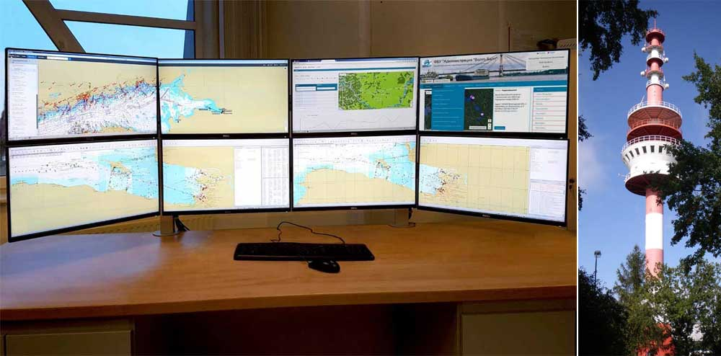

Onshore the marine and the river segments (VTS)
In 2016, the equipment main marine and main river VTS are installed in Coastal Vessel Traffic Services - VTS (Petrodvorets) and in river segment – VTS on inland waterways (Shlisselburg).
In 2018, three additional VTS were deployed: one in the maritime segment (in the pilotage service in St. Petersburg) and two in the river segment (in the Dispatching offices of the Sviritsa and Otradnoe settlements).
Marine and river VTS locations.

Slide 9
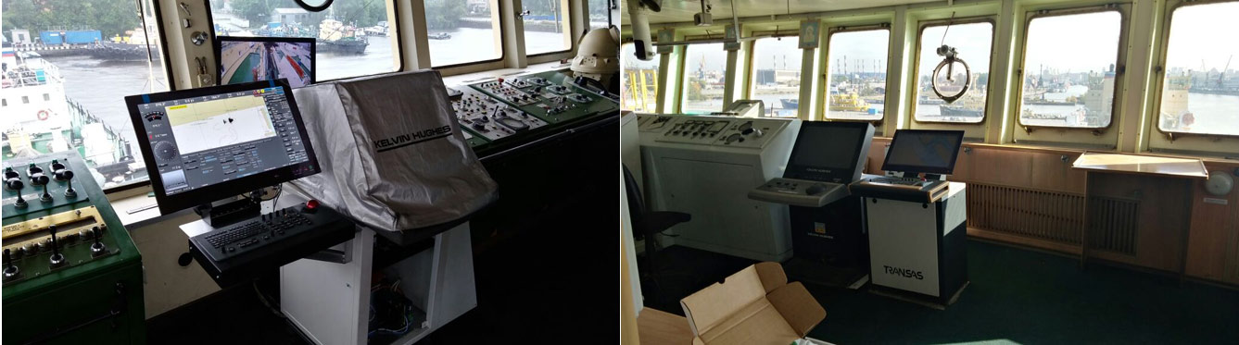
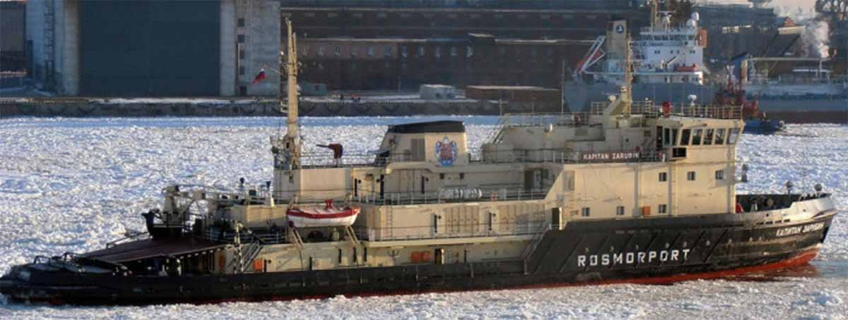
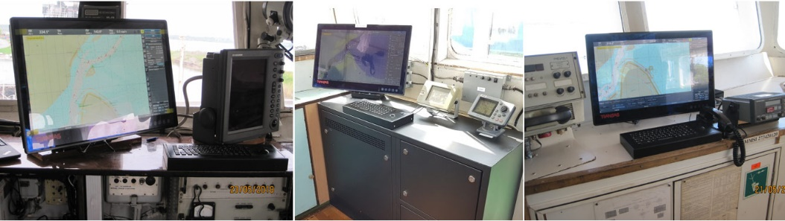
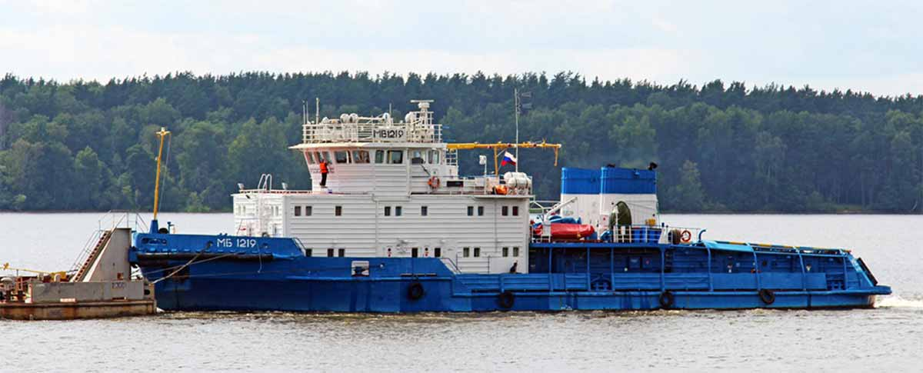
The ship the marine and the river segments (ECDIS)
ECDIS with e-Navigation functions is elaborated to 7* marine and 5** river vessels
* North-Western Basin Branch FSUE “Rosmorport”
** Inland waterways administration "Volgo-Balt"
Examples of marine vessels bridges
Sea icebreaker "Captain Zarubin"
Examples of river vessels bridges
River Tugboat "MB-1219"

Slide 10
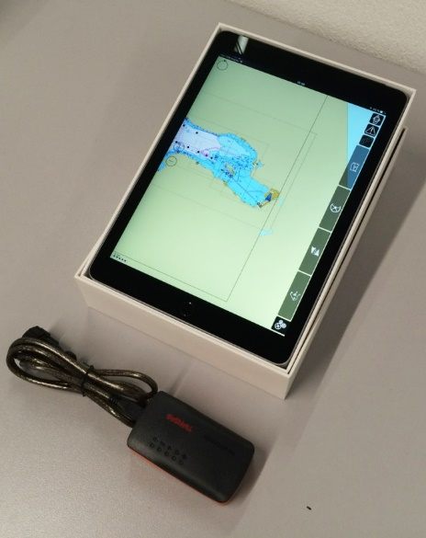
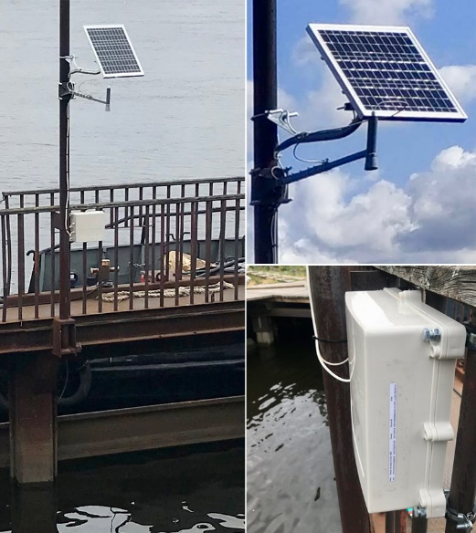
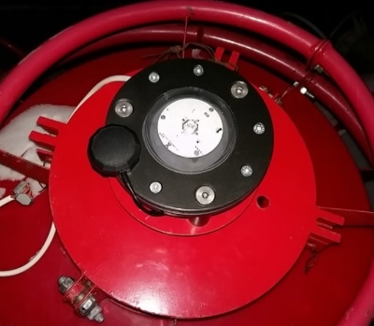
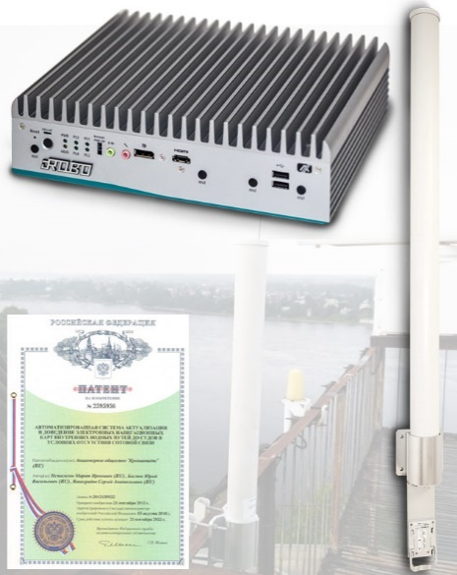
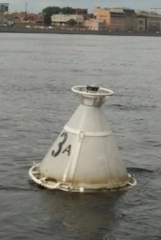
Additional Equipment of the Testbed
Personal pilot kit with e-Navigation functions - navigation application for pilot organizations
Water level meter - provides information about the water level by GSM communication in VTS
Synthetic AIS AtoN - sends information about your location by GSM communication or Iridium SBD in VTS
The ENC Remote Transmission System: access to the Internet, ENC database, etc. via Wi-Fi for a range of up to 3 km. Invention patent

Slide 11
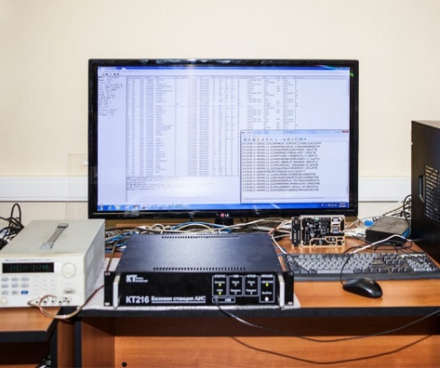
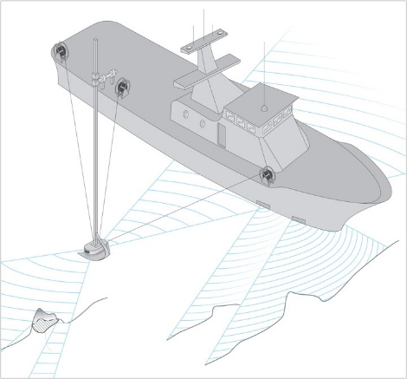
Perspective projects within the e-Navigation testbed
VDES
In 2018, within R&D "e-Sea" project developed and tested a model of the VDES coastal and shipborne equipment.
In 2020-2021, within the framework of MariNet, it is planned to develop serial equipment of VDES.
Automated Hydrographic Trawling System (AHTS)
AHTS - for high-precision and reliable detection of obstacles lying on the seabed. It has a special lowered platform with two side-scan sonars emitting in a horizontal plane. Additionally, a multibeam echo sounder and a third side-scan sonar are located on the vessel. Invention patent.

Slide 12
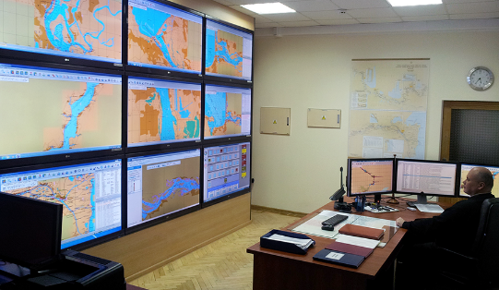
Site testbed "Hermitage" and the portal of RIS
In 2018, a website of the testbed was developed (see picture on the left) - https://enav-hermitage.ru/en/ .
In 2019, it will be updated and fully translated into English.
As our company had previously developed in 2012 web portals for River Information Services (RIS) for the Inland waterways administration "Volgo-Balt" (St. Petersburg, Russia) and Ukraine (on the Danube), we decided to develop a new RIS portal for "Volgo-Balt".
In the new work we are trying to implement the recommendations of PIANC "e-Navigation For Inland Waterways", the key documents of IMO and IALA on the e-Navigation strategy.
Work is scheduled to be completed in 2020.

Slide 13
Promotion of e-Navigation technology
The site of the testbed in the "e-NAV Library" section contains more than 30 key documents and articles on e-Navigation, including about 15 IMO and IALA documents that the Kronstadt Group translated into Russian.

Slide 14
The use of unmanned aerial vehicles
The Kronstadt Group is one of the leading Russian developers of large unmanned aerial vehicles (UAVs) of the HALE and MALE class. In addition, we actively use small UAVs to perform practical tasks of monitoring the earth's surface.
As part of the testbed project, we decided to conduct a study of the capabilities of the UAV for solving the problems of inland waterways (control of buoys, objects on the shore, operational monitoring of incidents, ice conditions, etc.). In 2018, test studies were conducted on a short stretch of the river (see photo).
In 2019, a survey of the entire Svir River (224 km) is planned at various altitudes, with various sensors (photo, video, IR, lidar, etc.).

Slide 15
Organization of interaction with STM
Current situation: about 50 vessels operating under the STM come to the ports of St.Petersburg (of which 20 are Russian - Sovkomflot, etc.). When the Hermitage and STM testbeds work together, this will not only improve the safety of navigation in the Gulf of Finland, but also give additional practice to VTS operators and navigators.
This is a difficult task in organizational terms, but we have already begun to jointly solve it. The Swedish Maritime Administration has prepared a letter addressed to us. We sent it to the Ministry of Transport, explained the situation and received their support. The next steps are coordination with the agency (Rosmorrechflot) and authority (Rosmorport). We hope that the answer will be positive.

Slide 16
Problems and possible solutions
When creating a testbed and introducing e-Navigation, we ran into a number of problems.
1. Participation in the work of the testbed was an additional burden on the staff, so some of them were reluctant to deal with new tasks.
2. Not very high preparation of colleagues from the administration of inland waterways.
3. Lack of legislative base for the implementation of e-Navigation. Because of this, there were difficulties with the allocation of additional personnel, especially in the VTS.
4. Most of the marine ships included in the testbed are icebreakers, this is what makes it difficult to carry out practical tests .

Slide 17
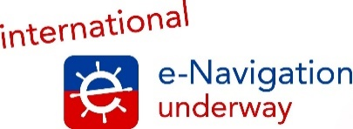
Thank you for your attention
Marat Ismagilov
Head of the testbed «Hermitage»
Director of Cartography and Hydrography Department
"Kronstadt Group“ (St. Petersburg, Russia)

