Slide 1

Maritime Messaging Service (MMS)
: The Value Transporter of the Maritime Connectivity Platform
8th Feb, 2019
Jin H. PARK, Ph.D.
Maritime Safety and Environment Research Division
Korea Research Institute of Ships and Ocean Engineering
Note: This presentation contains results of SMART-Navigation Project contributed by SNPO and its partners.

Slide 2
“Shannon and Weaver Model of Communication”

Slide 3
”MCP (formerly known as the Maritime Cloud) is a communication
framework enabling efficient, secure, reliable and seamless electronic
information exchange between all authorized maritime stakeholders
across available communication systems”

Slide 4
Communication vs. Connectivity

Slide 5
The Fairway to Maritime Services
MARITIME CONNECTIVITY PLATFORM

Slide 6
Barriers against connectivity at sea (in terms of technology & business)
  Expensive bandwidth
  Many chances of unfruitful service access: polling from server > push to user
  Communication link changes during service subscription
  Use of different communication links between ship and ship/shore
  Reluctance to share ship’s location with others: highly sensitive business asset
  Cast-and-forget communication model: broadcast

Slide 7
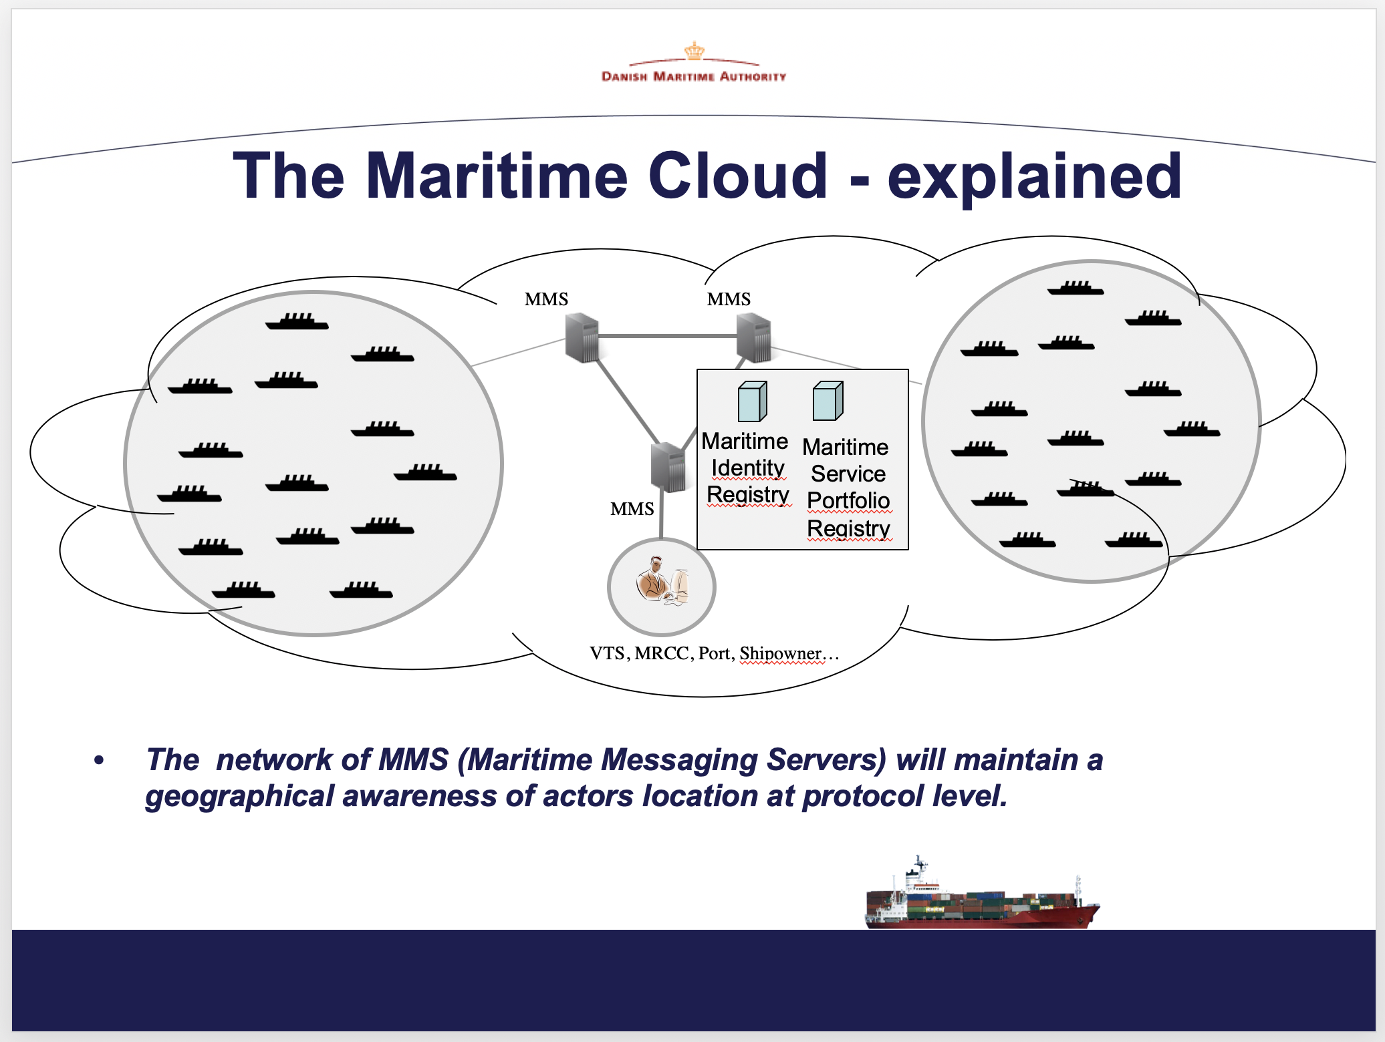
Thomas Christensen, 1st International Global e-Navigation Testbed, KRISO, 2013

Slide 8
Jin H. Park, e-Navigation Underway, Copenhagen, 2015

Slide 10
Distributed and federated operation of MMS instances
Network-agnostic information delivery
Securing confidentiality of user-generated information
Easy provision and use of location-based service at sea
Reflection of communication link usage for connectivity at sea
System design based on up-to-date market standards
Incorporation of widely used & proven open source components
Vigilance in quality-of-service (QoS) management

Slide 11
Inter-MMS message exchange
Connectivity quality management
Message relaying
Service-call brokerage
Message queueing
Group-casting

Slide 12
SC4
SC5
SC1
Shipping company
SP1
Gateway
SC2
MMS 1
MMS 2
SP2
SC3
MIR
MSR
SC6
SP3
MMS 3
SC7
SP4
SP5
SP6
IP Network
Non-IP Network
Maritime service company

Slide 13
Inter-MMS message exchange (for MMS federation)
⑥ Queue MSG
SP1
⑤ Check Subscription (Home/Visited-MMS)
① Send MSG to SP2
④ Forward MSG
Ship 1
MMS 1
MMS 2
③ Get Home-MMS
② Check Subscription (Home/Visited-MMS)
⑦ Push or Long polling MSG
Ship 2
Wired IP Network
MIR/HM
SP2
Wireless IP Network

Slide 14
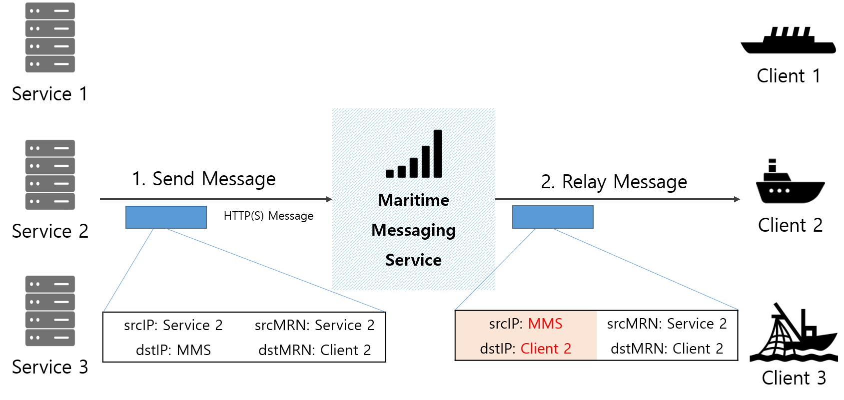
Message relaying: “using identifiers rather than locators”

Slide 15
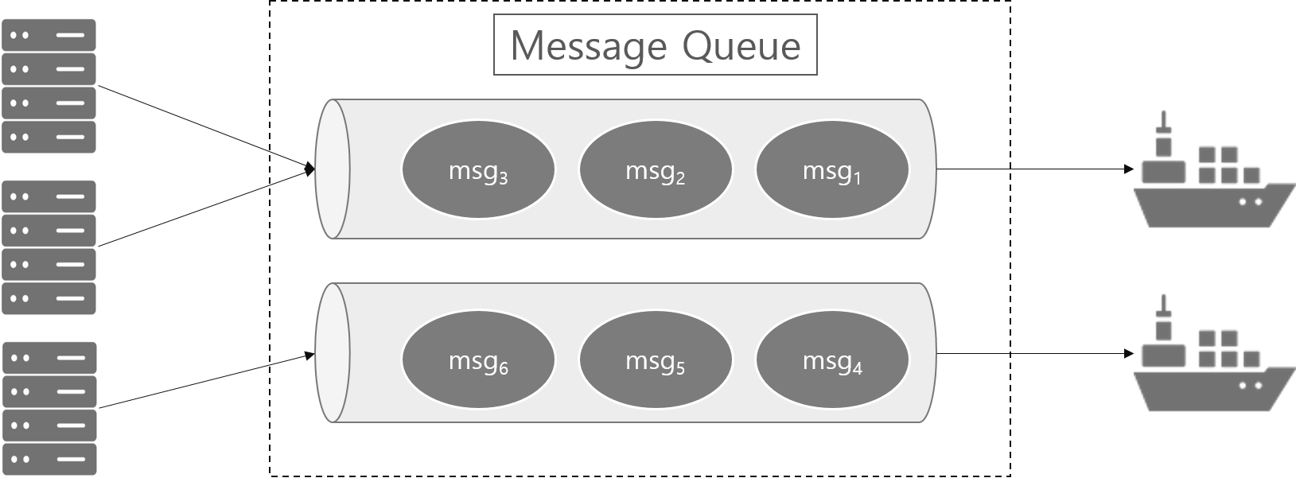
Message queueing

Slide 16
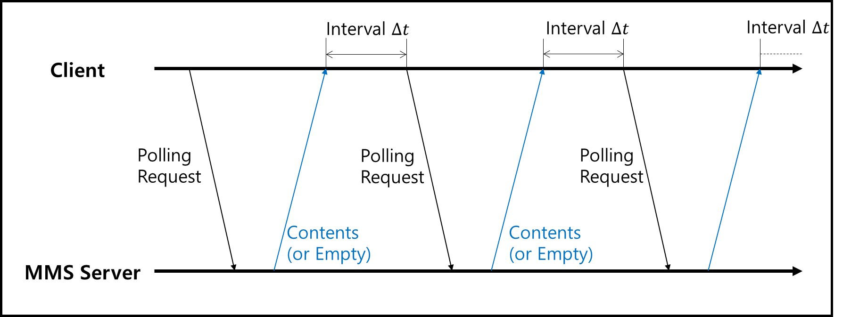
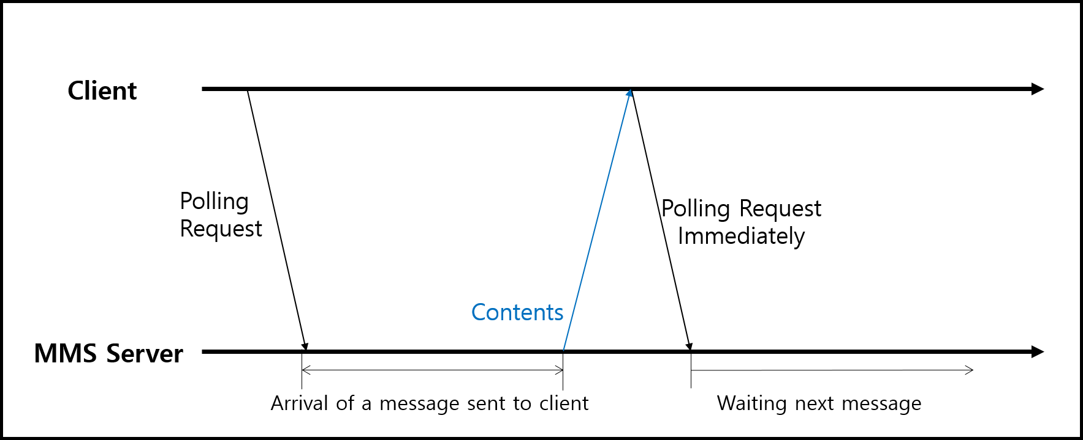
“Long polling for efficiency”

Slide 17
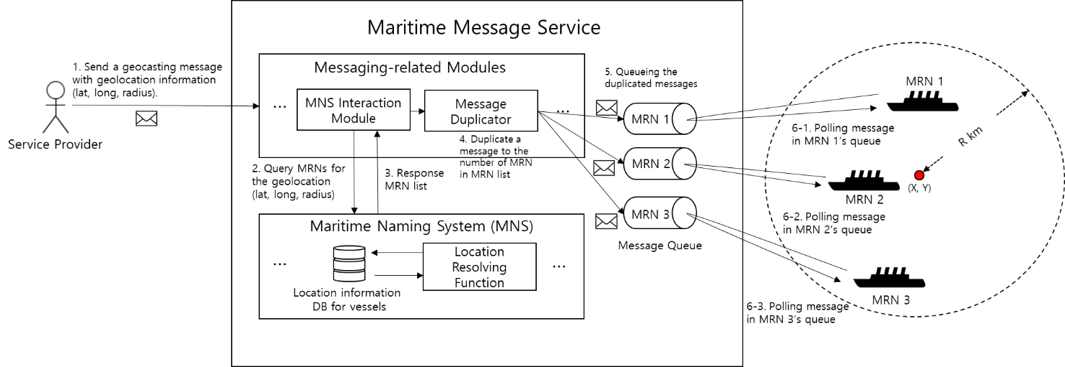
Group-casting

Slide 18
Service-call brokerage (API-gateway)
⑪ Queue MSG
⑥ Parching MSG
⑧ Service Call using URL endpoint
SP
MMS
⑩ Response MSG
⑦ Long-Polling
⑨ Backend process
④ Request service-call brokerage
⑤ ACK Request SVC
⑦ Request URL of the Service
⑫ Dequeue the MSG
SC
① Search SVC
MSR
② Return SCV info & MRN
③ Select SVC

Slide 19
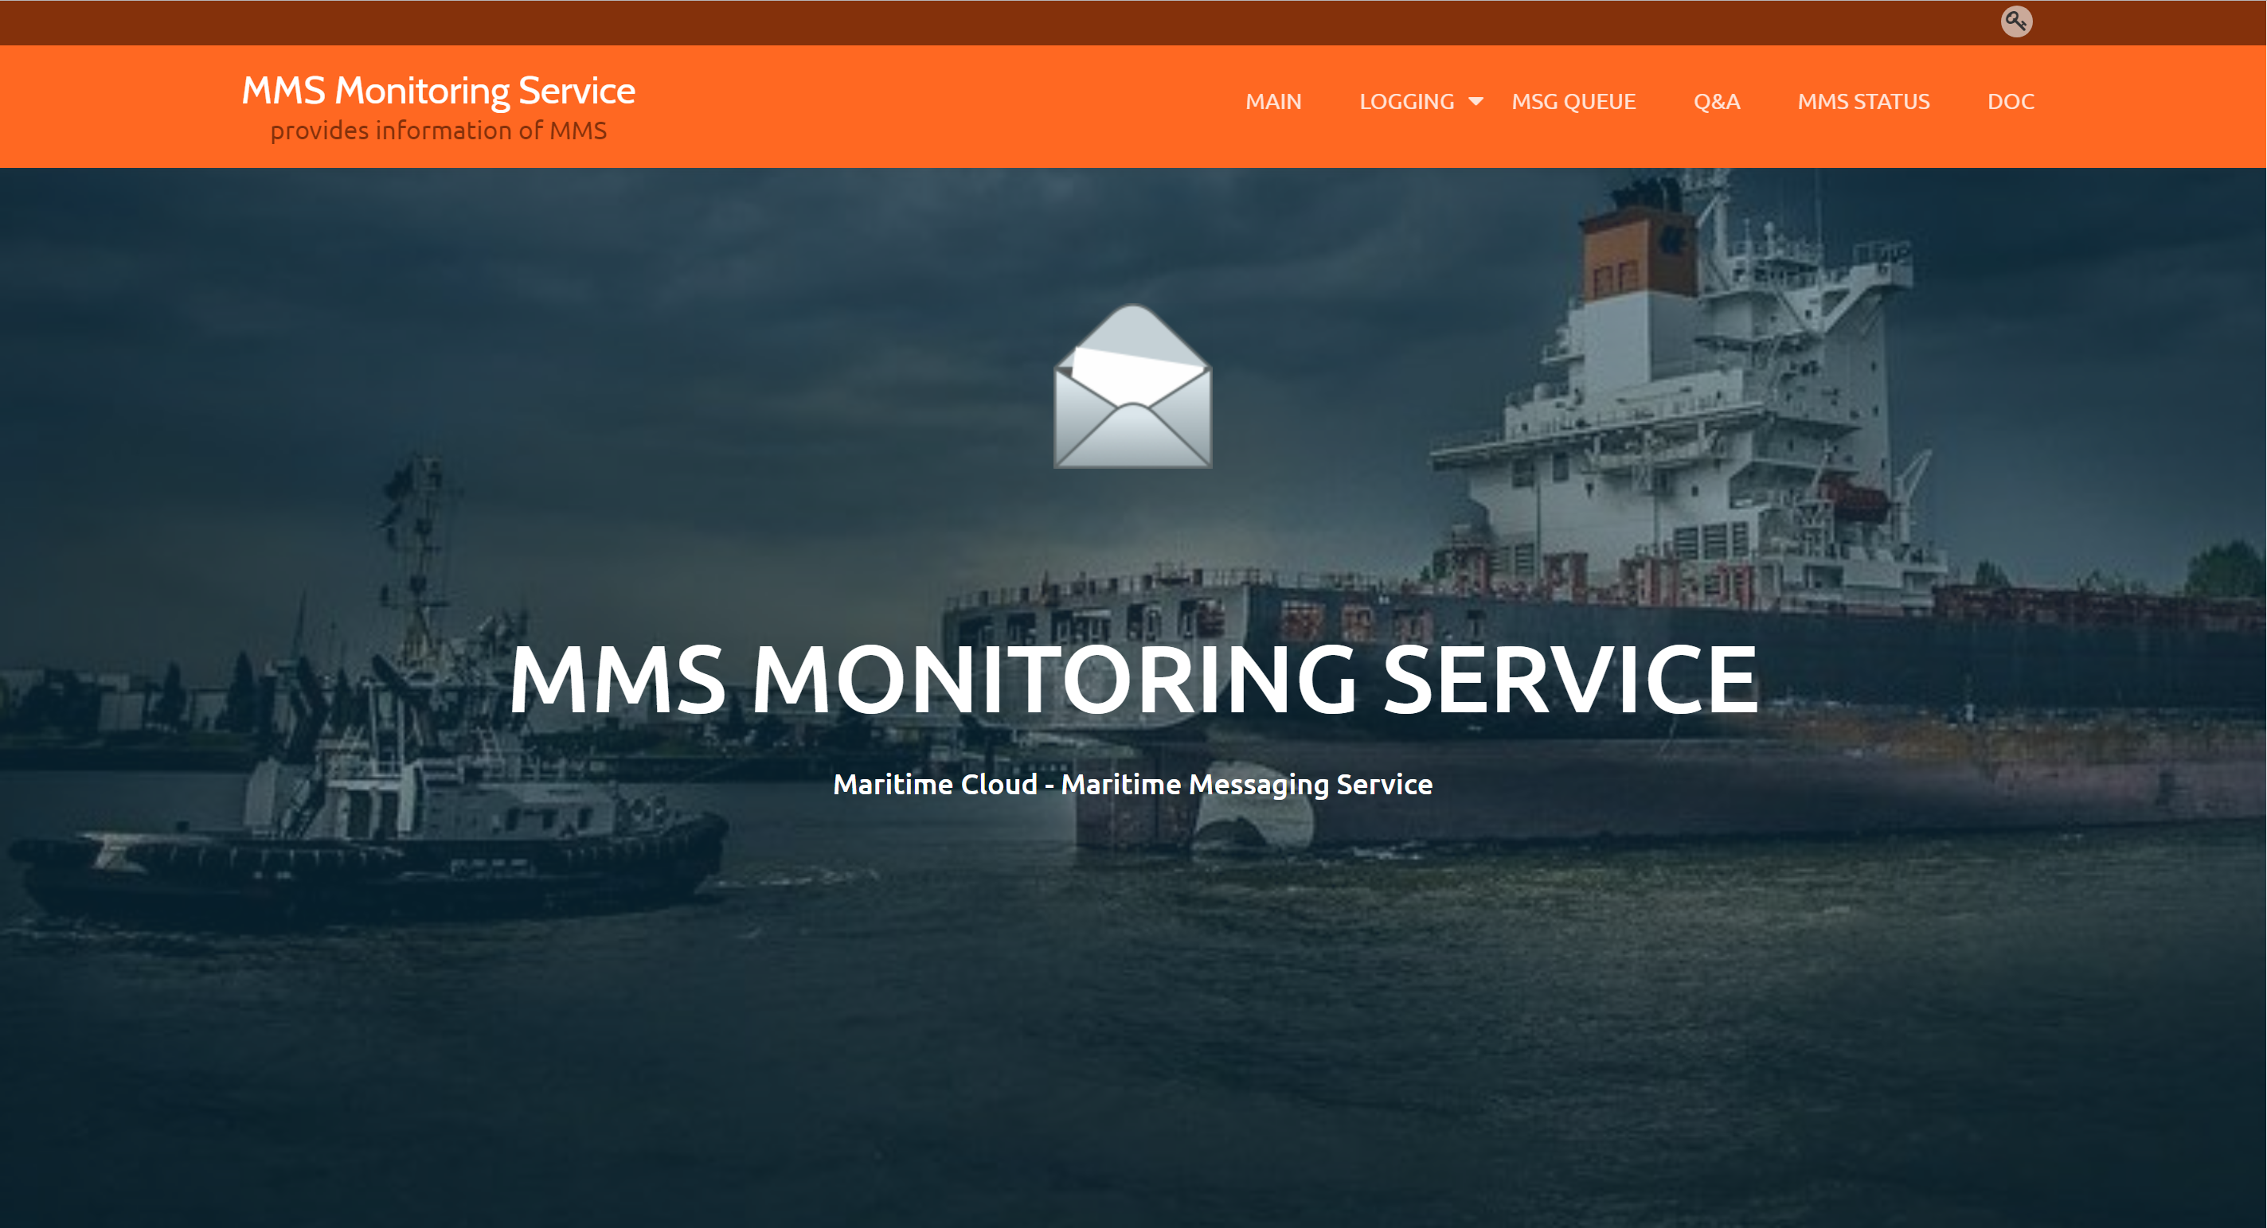
Connectivity quality management

Slide 20
SC4
SC5
SC1
Shipping company
SP1
SC2
SP2
SC3
SC6
SP3
SC7
SP4
SP5
SP6
IP Network Node
Non-IP Network Node
Maritime service company

Slide 21
SC4
SC5
SC1
Shipping company
SP1
Gateway
SC2
MMS 1
MMS 2
SP2
SC3
MIR
MSR
SC6
SP3
MMS 3
SC7
SP4
SP5
SP6
IP Network
Non-IP Network
Maritime service company

Slide 22
⑫ Queue MSG
⑨ Validate cert.
⑤ Relay MSG (Request SVC)
SP
MIR
MMS
⑩ Authenticate
⑥ ACK Request SVC
⑪ MSG from SVC
⑧ Long-Polling
⑦ Backend process
④ Request service
⑦ ACK Request SVC
⑬ Dequeue the MSG
SC
① Search SVC
MSR
② Return SCV info & MRN
③ Select SVC

Slide 23
SC4
SC5
SC1
Shipping company
SP1
Gateway
SC2
MMS 1
MMS 2
SP2
SC3
MIR
MSR
SC6
SP3
MMS 3
SC7
SP4
SP5
SP6
IP Network
Non-IP Network
Maritime service company

Slide 24
Maritime
Service
Ship
MMS
Tunneling by HTTPS
Payload encryption

Slide 25
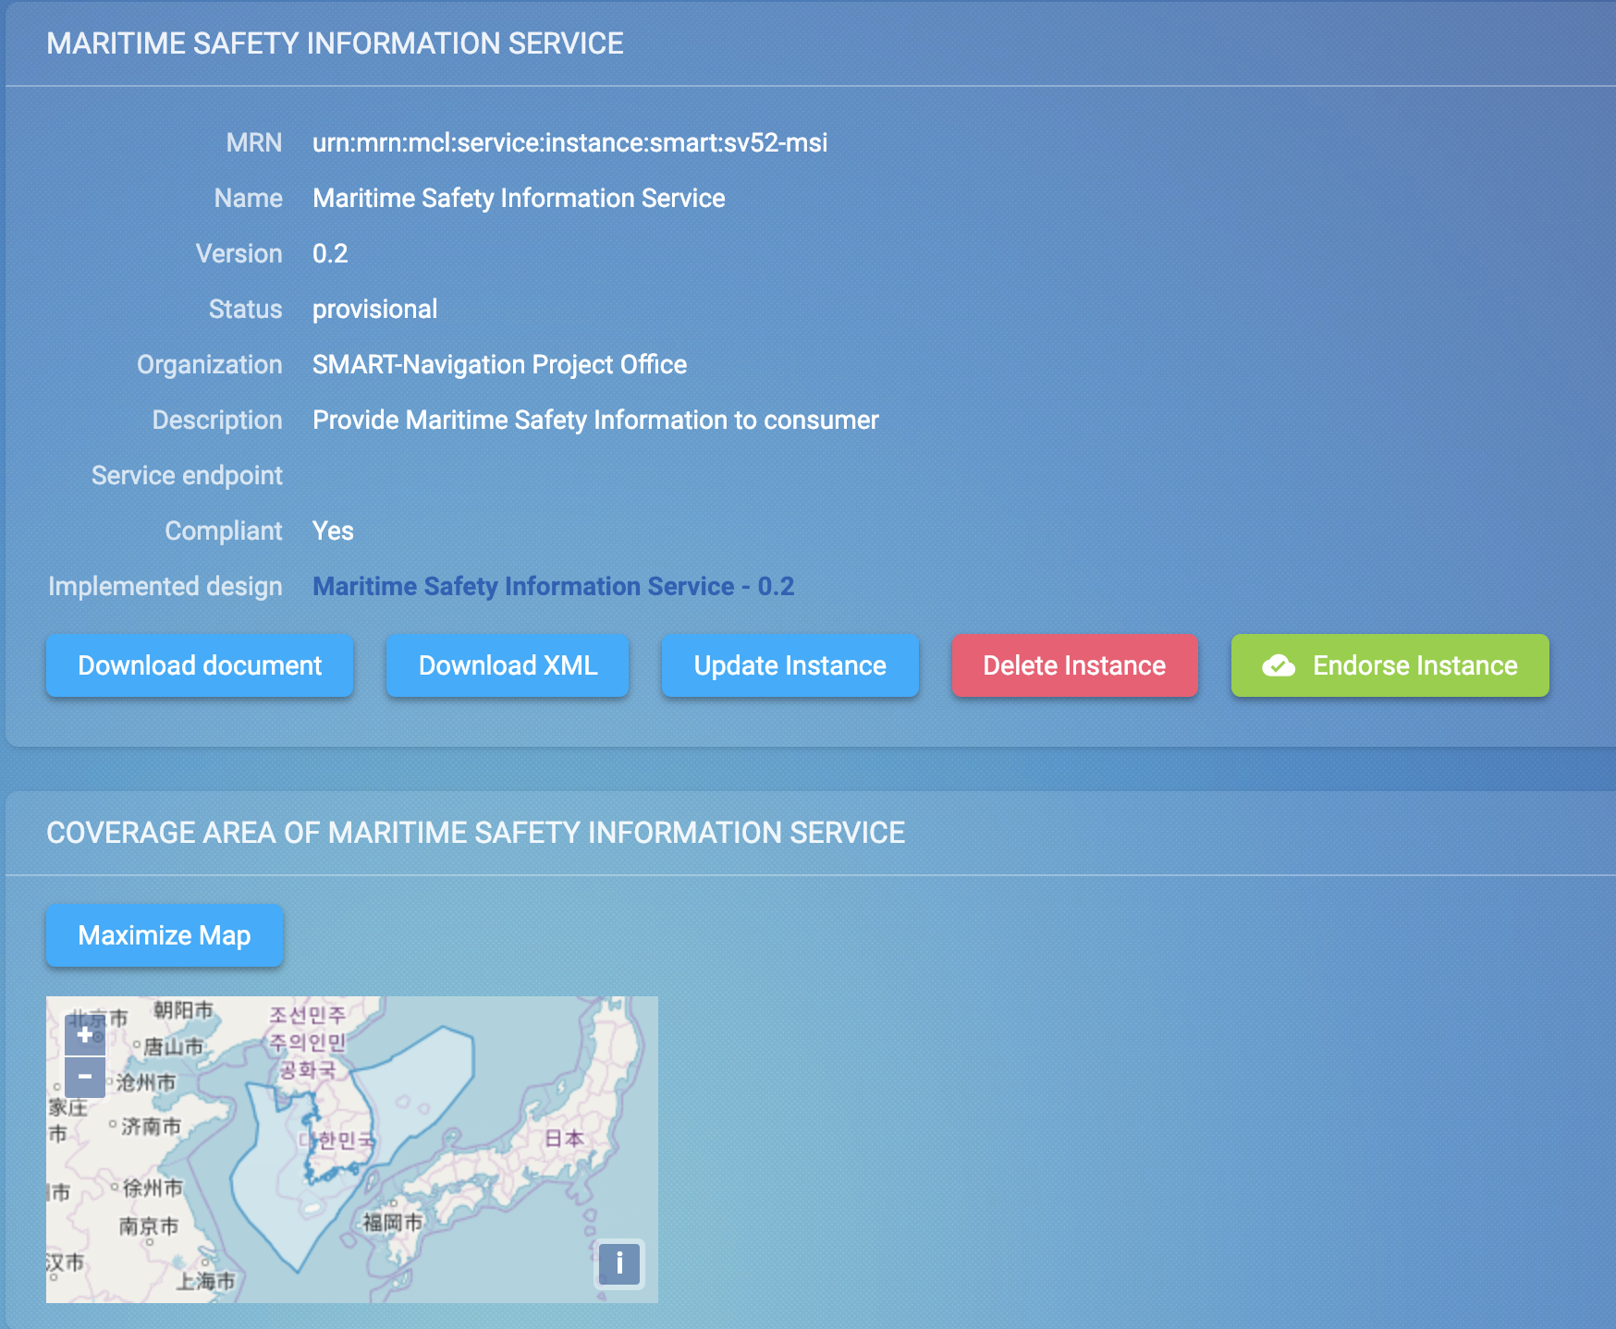

Slide 26
E-Navigation service subscription
“with MMS”
“without MMS”

Slide 27
E-Navigation service subscription
SV30
SP20
MMS
SHIP,SV30,A,B
SHIP
SV10
OK
…
SV52

Slide 28
E-Navigation service subscription
SV30
SP20
MMS
SHIP,SV30,A,B
SHIP
SV10
…
SV52

Slide 29
SV30,SHIP,RTZ1
E-Navigation service subscription
SV30
SP20
MMS
SHIP
SV10
…
SV52

Slide 30
E-Navigation service subscription
SV30
SP20
MMS
SV30,SHIP,RTZ1
SHIP
SV10
…
SV52

Slide 31

Geochrono-casting
Anti-Piracy
MMS
: Jin Shipping

Slide 32
Geochrono-casting
Anti-Piracy
AP,JS,Pirate
MMS
: Jin Shipping

Slide 33
Geochrono-casting
Anti-Piracy
MMS
: Jin Shipping
AP, SHIP1,Pirate
AP, SHIP2,Pirate
AP, SHIP3,Pirate

Slide 34
Network-agnostic message exchange
SC1
SC2
MMS 1
SC6
SC3
Route plan in RTZ
MMS 2
SC7
SP3
MMS 3
SP4
SAT Network
LTE Network

Slide 35
Multi-modal Seamless roaming (MMSR): vertical handover & buffering
MMS2
(Visited-MMS)
MMS1
(Home-MMS)
Non-IP-GW
HTTP MSG in IP Packet
HTTP MSG in Non-IP Packet
“IP”
Ship
Base Station
IP Network
Service
“Non-IP”
Non-IP Network

Slide 36
Benefits of MMS: connectivity to all maritime stakeholders
  One-point secure acces to all services
  Inter-operability between services
  Full use of existing services and systems
  Easy implementation of e-Nav. Services
  Inter-connections between physical links
  Less communication load (=cost)
Join the consortium!
Use the MCP!!
MMS is on your hands!!!

Slide 37
Maritime Connectivity Platform
: The Fairway to Maritime Services
Thank you very much!
감사합니다!
/Gahm-Sah-Hab-Ni-Dah!/
jin.h.park@kriso.re.kr

