Slide 1
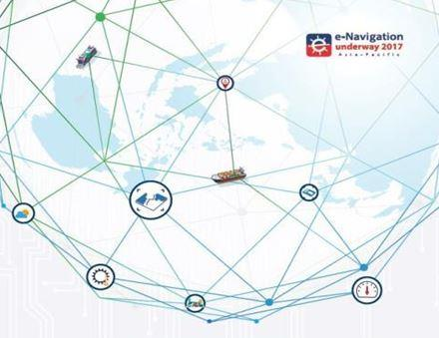

Sunbae Hong
Director and Head
SMART-Navigation Task Force
Ministry of Oceans and Fisheries

Slide 2

z
Attention, Please ~☺
May I withdraw you attention
to a very very very important thing !
More communities get their solutions from

Slide 3
z
Would you, please, never blame your ear,
if you do not understand my speech !
That is not your fault, but my fault !
Because my tongue is not made-in-UK, but
my tongue is Made-in-Korea !
Very Thanks Anette for Paving Digitalization World

Slide 4
z
Therefore, please ~☺
Do not make a difficult question to me~☺
Very Thanks Thomas for your hard efforts

Slide 5
z
Attention, Please ~☺
May I withdraw you attention, once more,
to a very very very important thing !
Very Thanks Francis for your leadership

Slide 6
z
Today
is the last day of Pre-MCP Era !, but
the first day of new Civilization toward
Post-MCP Era !
Thanks Ourselves for our devotion

Slide 7

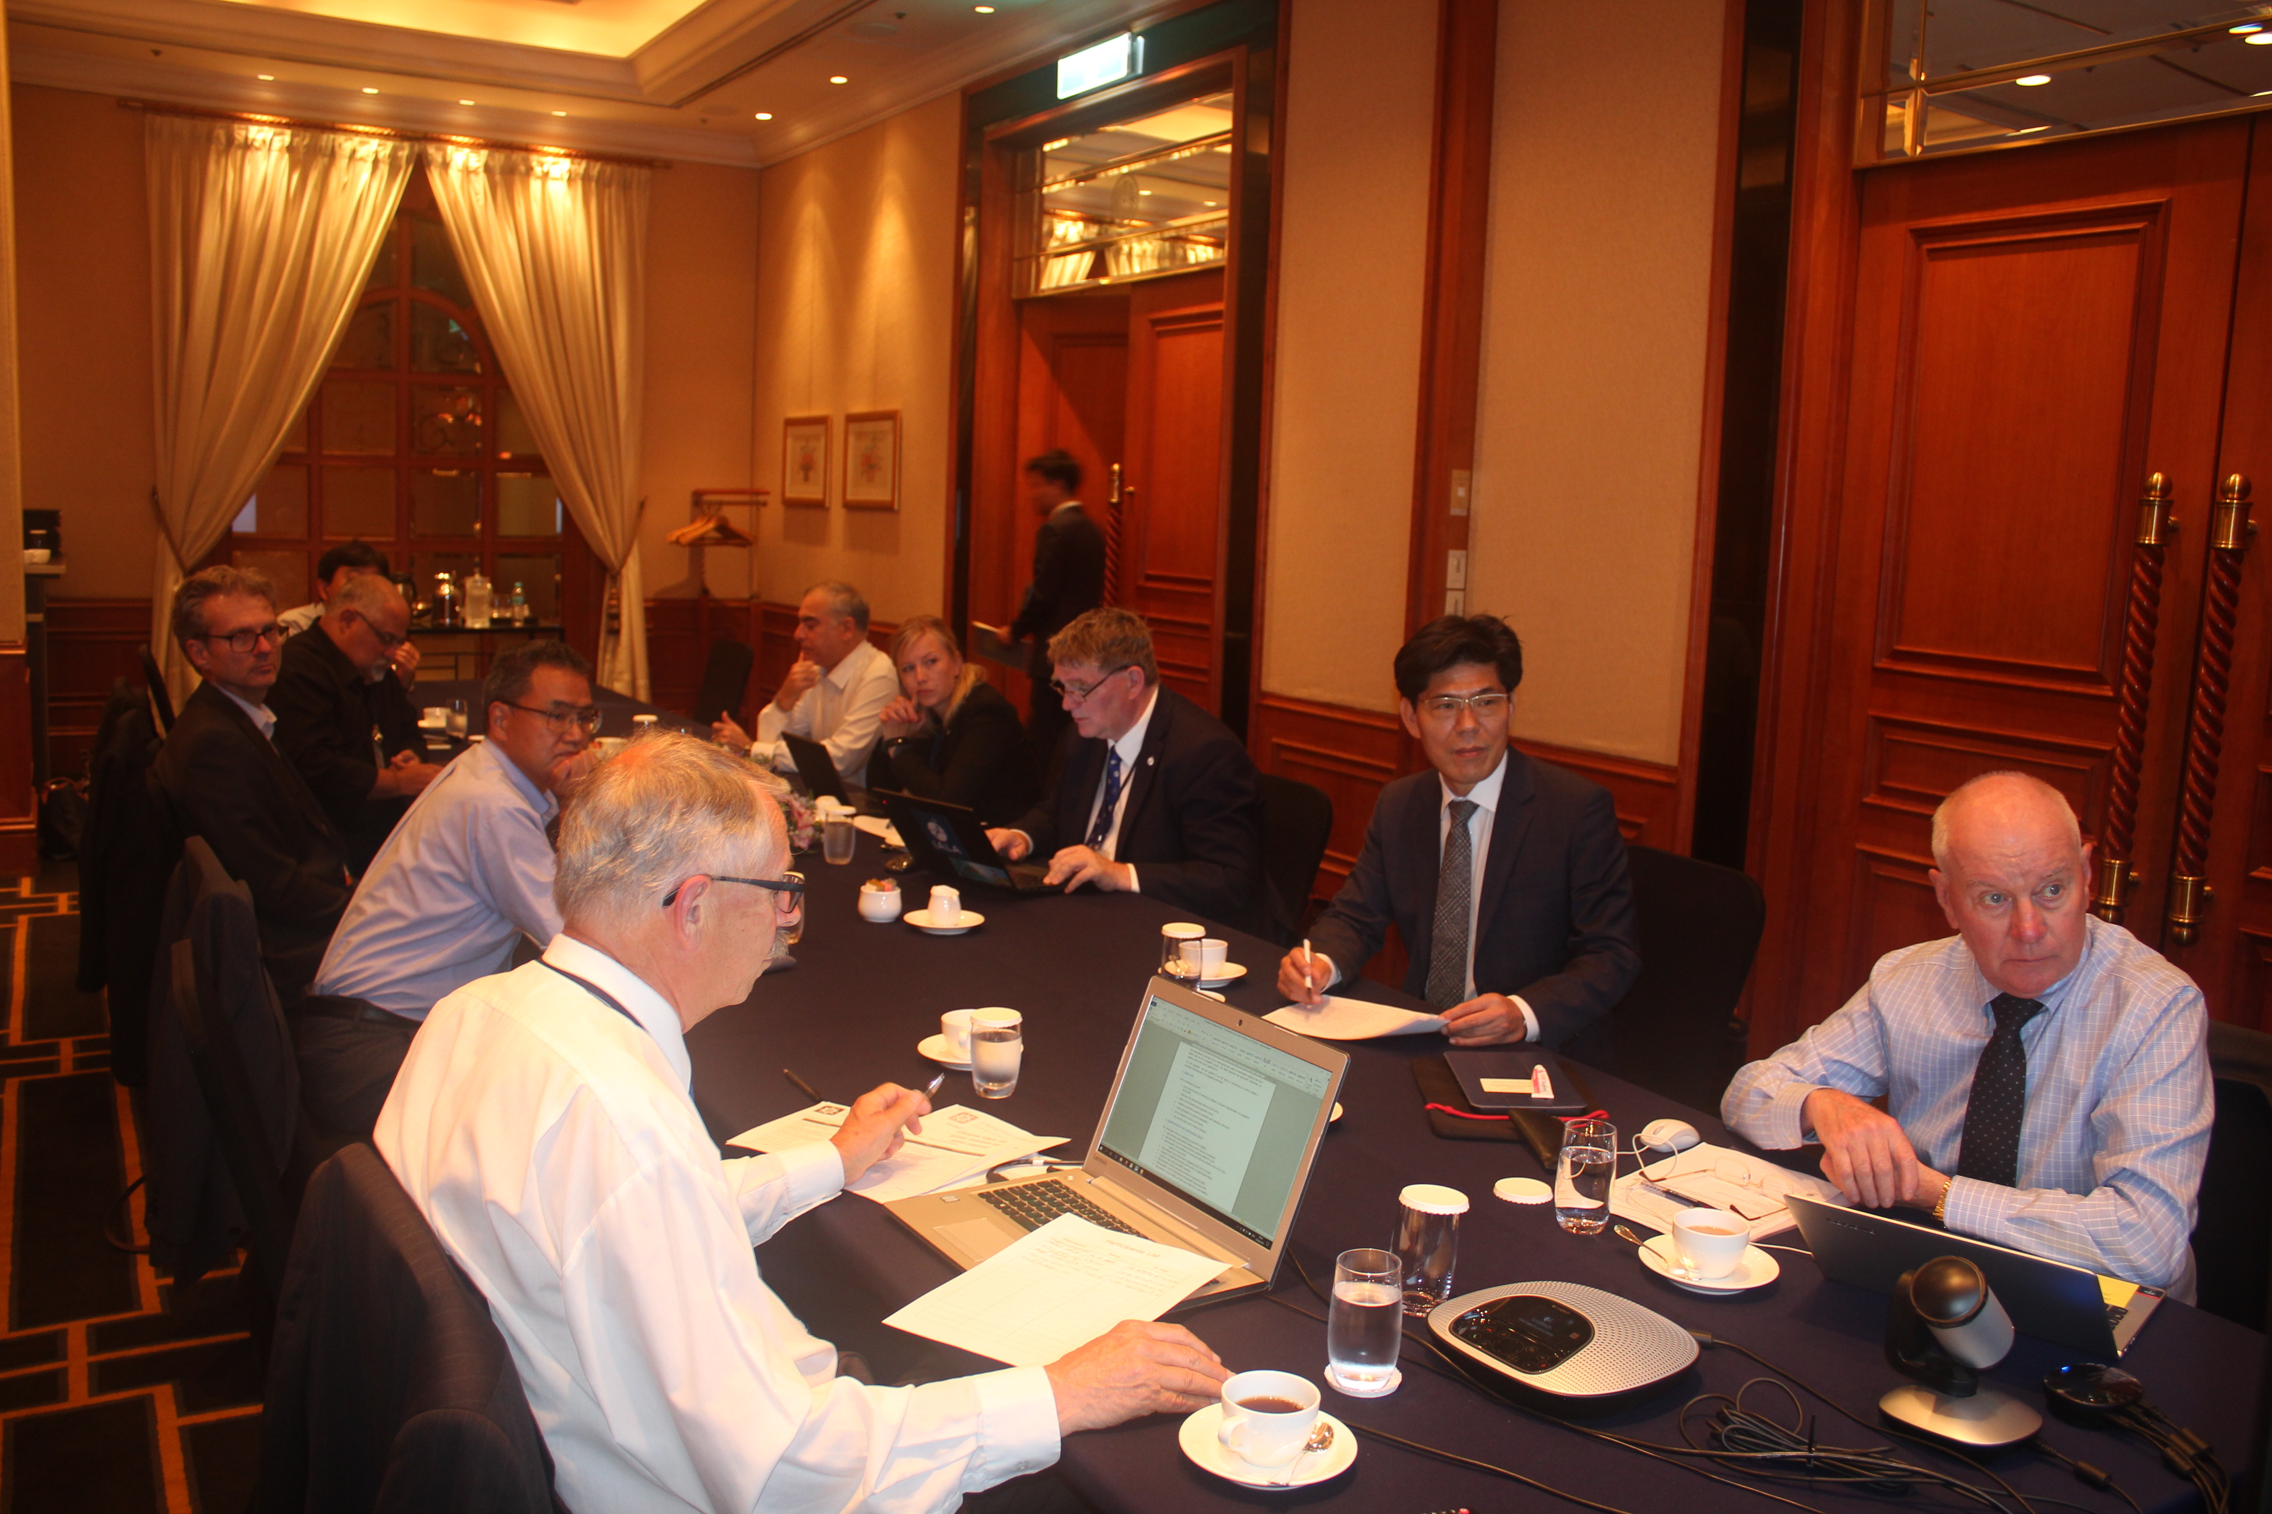
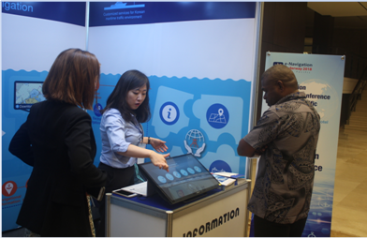
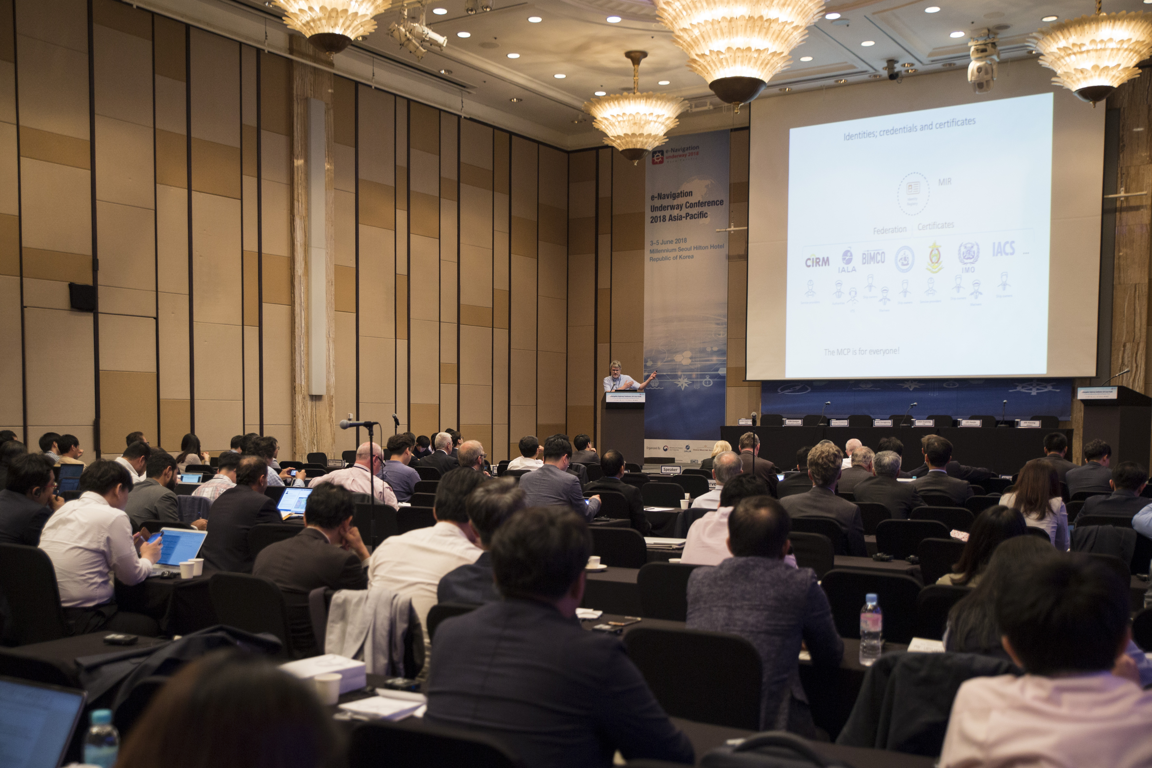
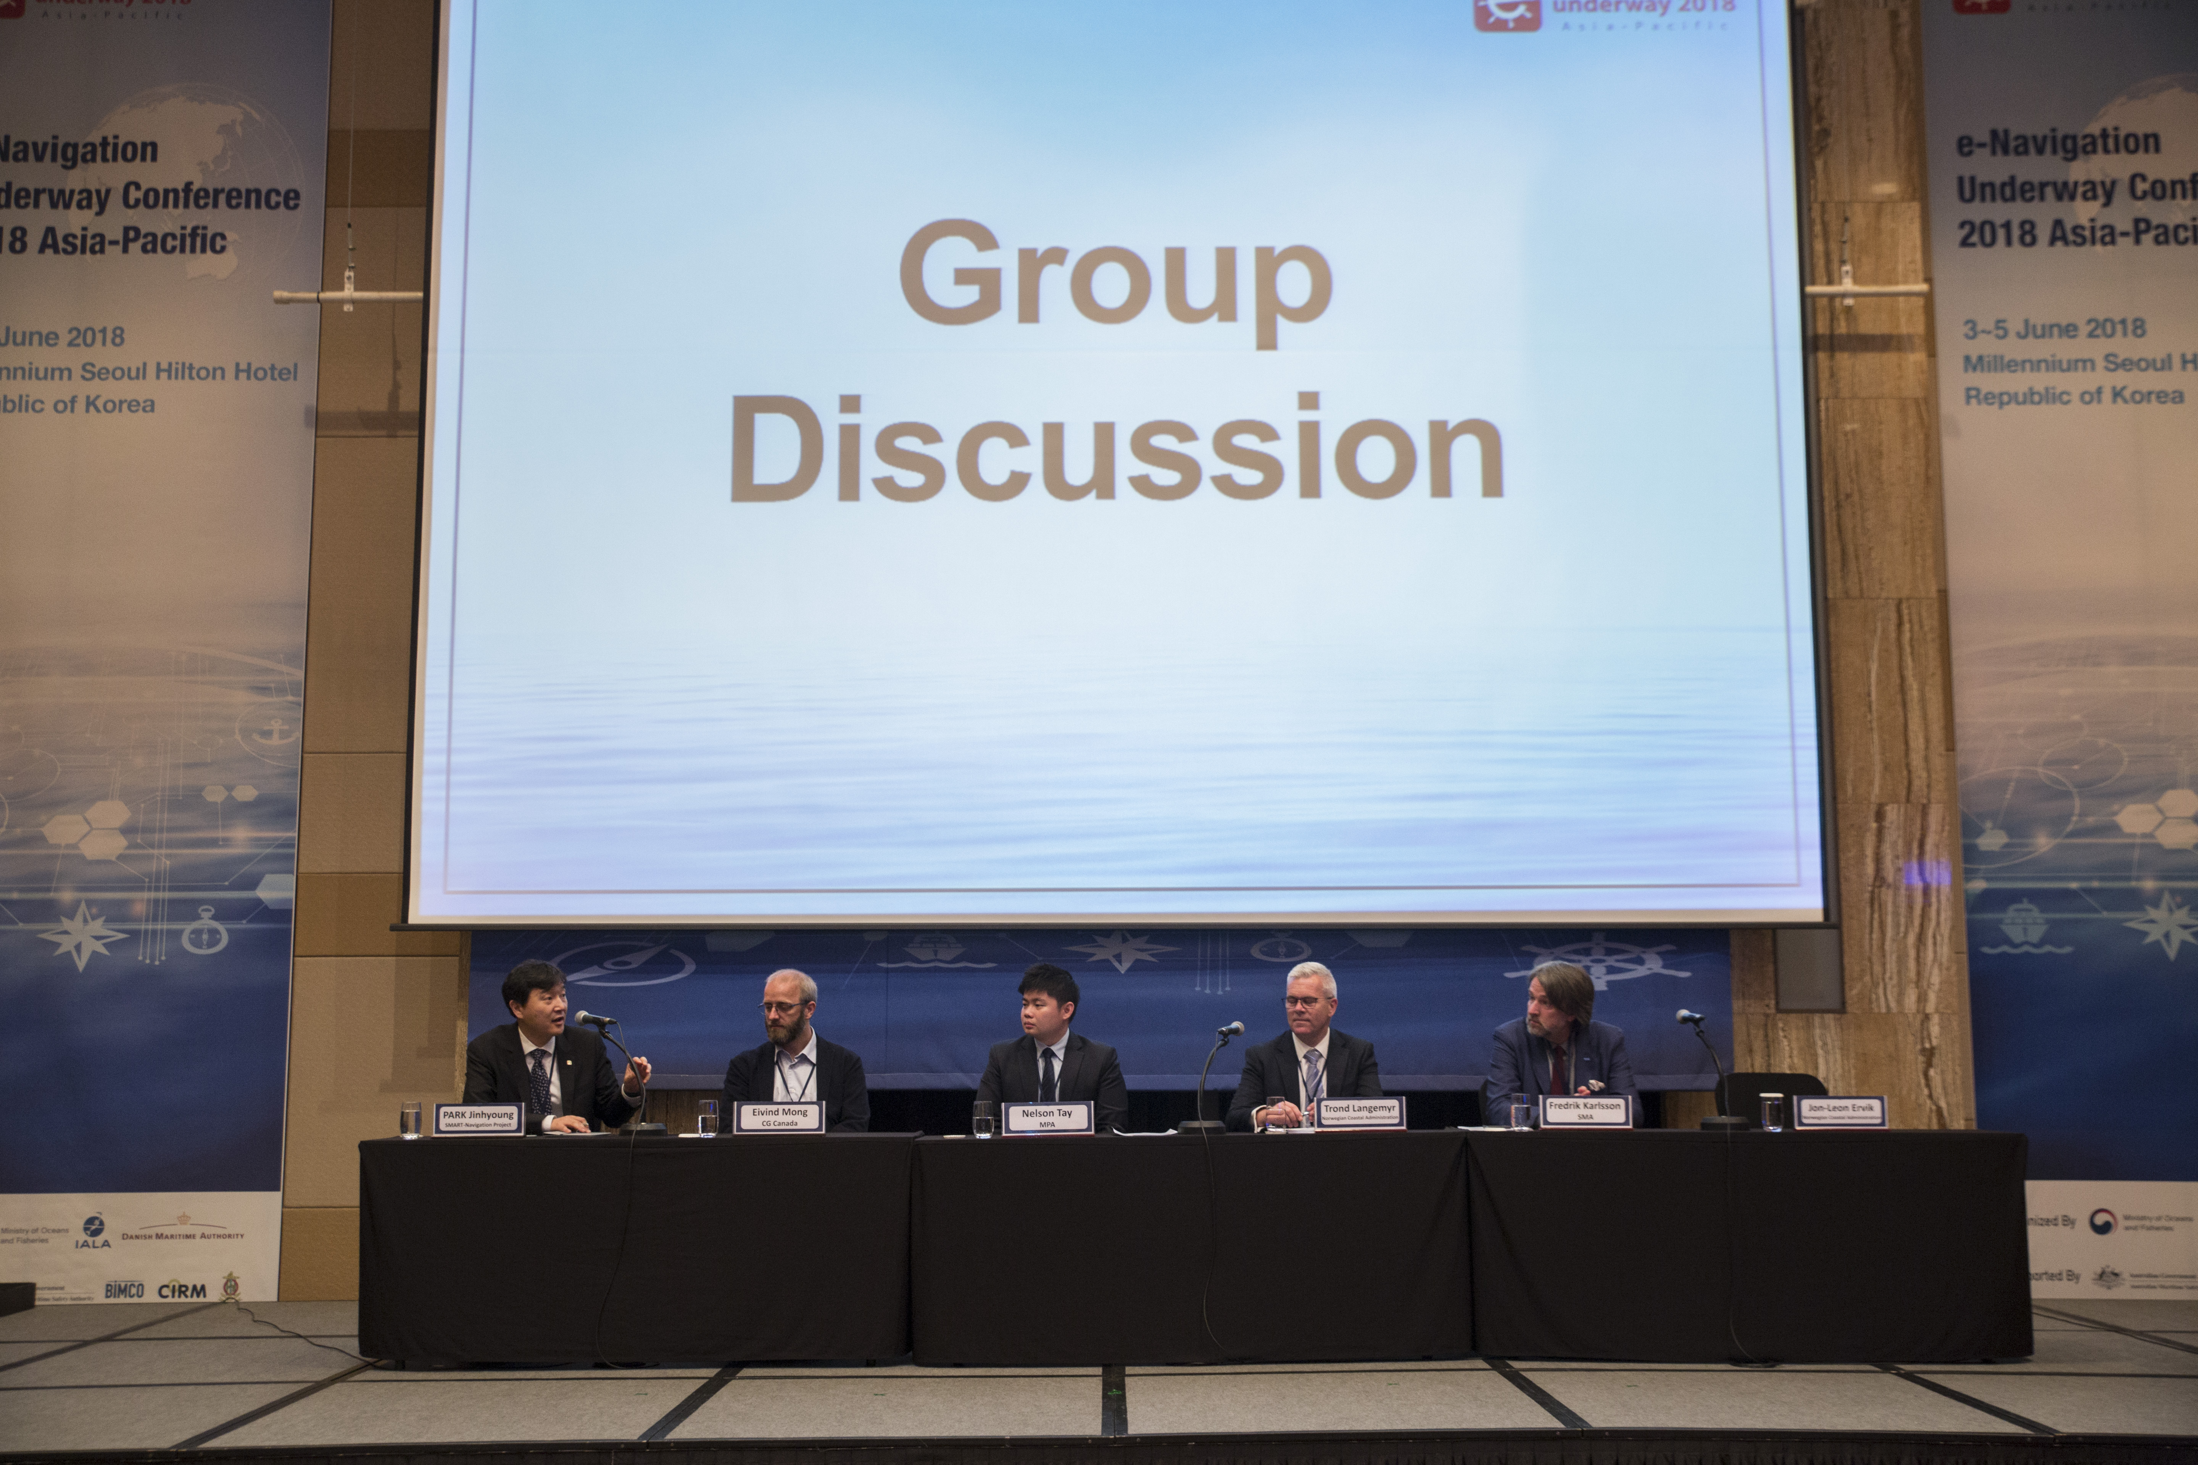
Registration
Registration fee 200 USD (tentative)
Registration open from March 01 2019
To register visit www.e-navAP.org

Slide 8

Themes
Implementation of e-navigation
in the Asia Pacific: Next Agenda
Session
1
Global e-Navigation Service Best Practice
and Platform
Session
2
Emerging Technology: MASS, Cyber Security and Beyond e-navigation
Session
3
Maturing e-navigation: Capacity building, Training and Education, Governance
Session
4
Panel Discussion and Highlights Summary

Slide 9

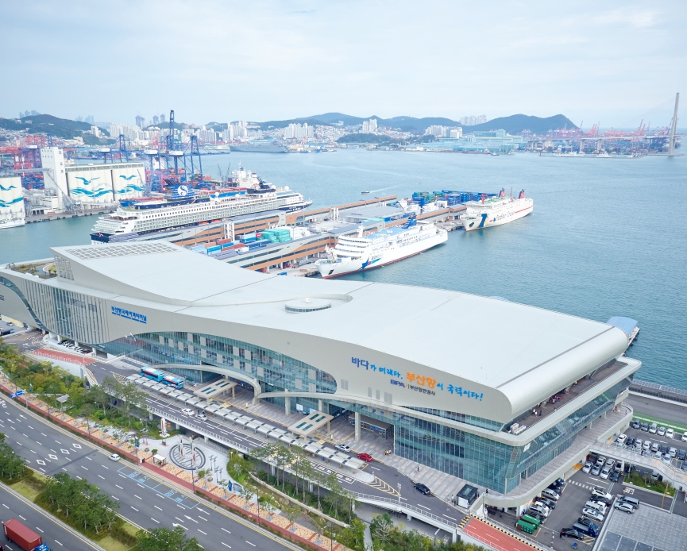
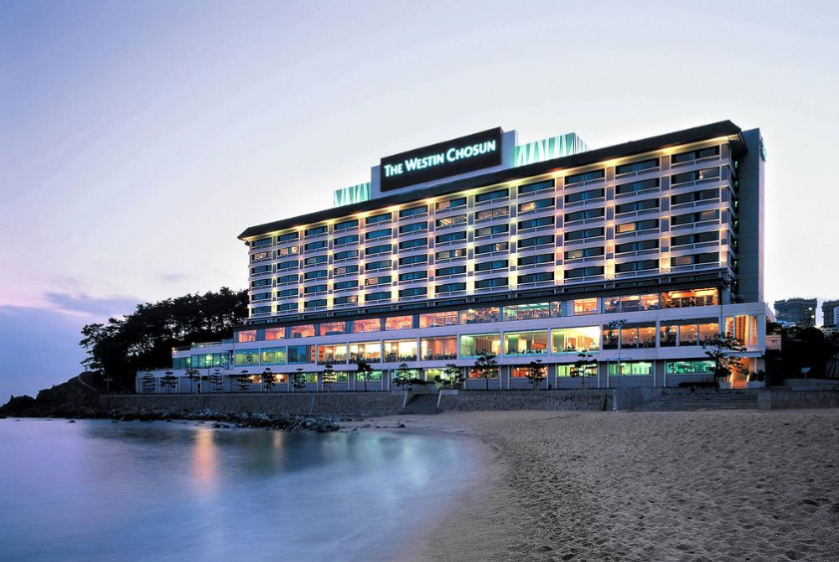

Venue ?
Place 1
Place 2
Place 3
Let’s see the result of vote at web(http://sli.do) Room name : ENUW Asia-Pacific 2019

